Slide 1
VII International Conference “Development History: inside view”
CORPORATE SOCIAL RESPONSIBILITY AND SUSTAINABLE DEVELOPMENT.
June 28-29, 2016
Almaty

Slide 2
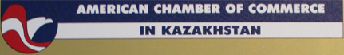
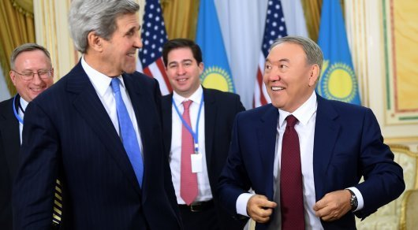
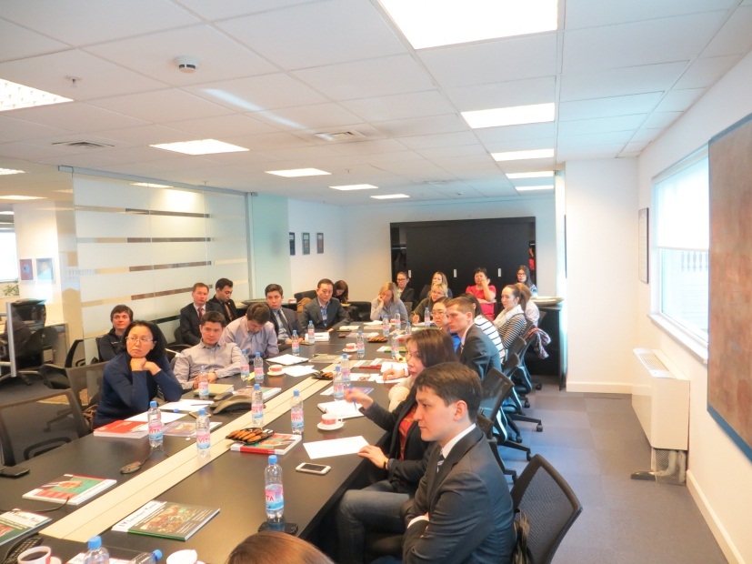
AMERICAN CHAMBER OF COMMERCE
The American Chamber of Commerce in Kazakhstan (AmCham) serves as the voice of the international and local business community by creating an open forum to exchange information, ideas, and experience doing business in Kazakhstan.
AmCham was founded in 1999 by an initial group of thirty-five American member companies. Today the Chamber represents over two hundred member companies, not-for profit organizations, international financial institutions, and individual members.

Slide 3

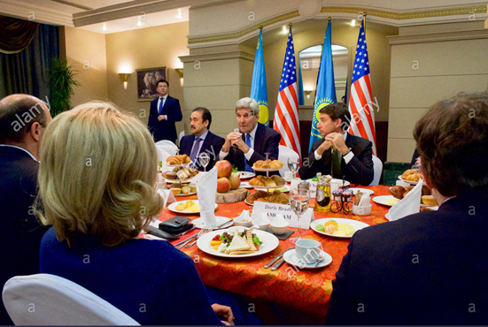
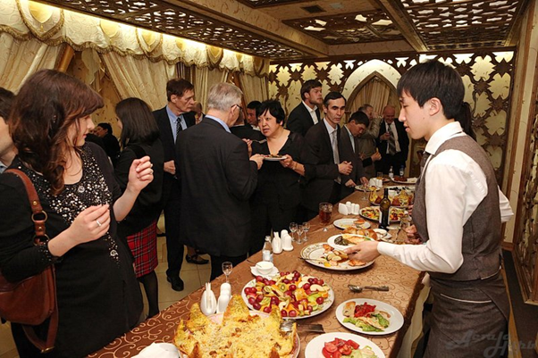
AMERICAN CHAMBER OF COMMERCE
Through its policy advocacy initiatives, AmCham provides opportunities for its members and host government officials to engage in an on-going dialogue with the intention of improving the business environment for foreign and local investors alike.
AmCham Working Groups are led by specialists in their fields and aim to understand, analyze, and improve the business environment in Kazakhstan. The 20 groups meet in Almaty, Astana, Atyrau, Aktau, and Shymkent to exchange ideas, educate members, and contribute to the policy debate in Kazakhstan.

Slide 4
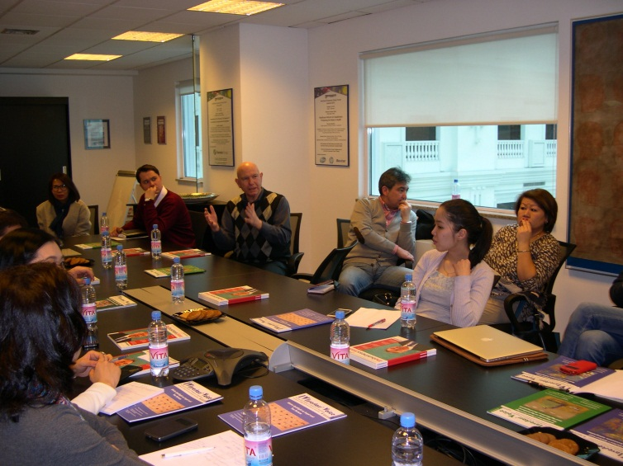
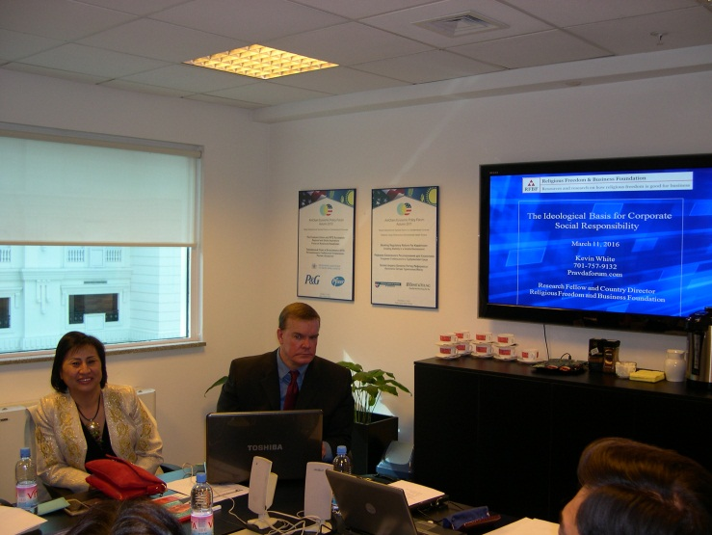
AMCHAM CSR WORKING GROUP
The Almaty CSR Working Group seeks to engage policymakers and businesses on how to best mobilize social capital in Kazakhstan.
The Group covers major topics that address environment, education, employment, charity and protection of animals.
Meetings feature presenters from a variety of companies and NGOs, providing members with the opportunity to discuss CSR successes and challenges in Kazakhstan, and to identify ways of improving the environment for CSR.

Slide 5
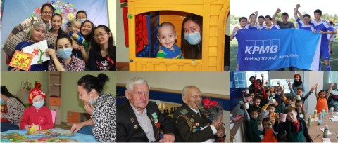
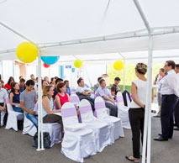
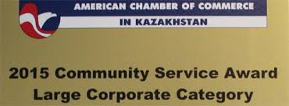
AMCHAM CSR WORKING GROUP
American Chamber of Commerce in Kazakhstan consists of a number of socially responsible businesses.
It has two CSR Working Groups in Almaty and Atyrau.
AmCham encourages companies to contribute to the society as well environment, education, employment, charity and protection of animals.
Each year AmCham selects best CSR projects and gives a Community Service Award to companies in two nominations: Large companies and Small companies.

Slide 6
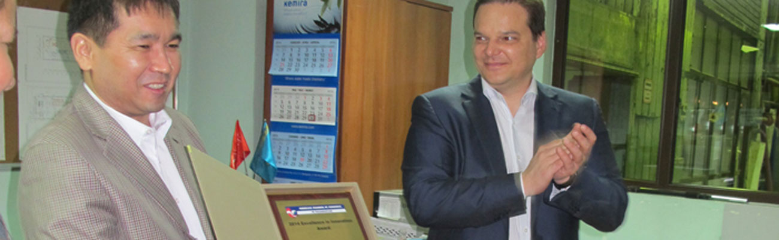

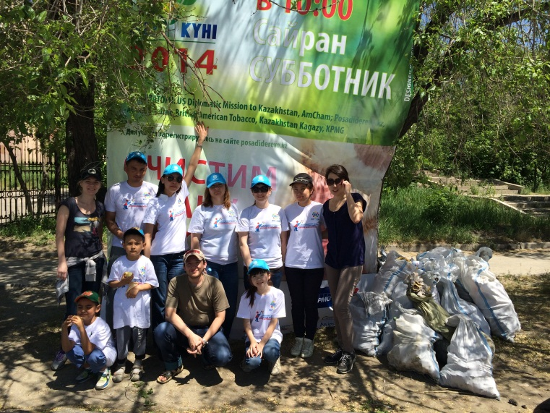
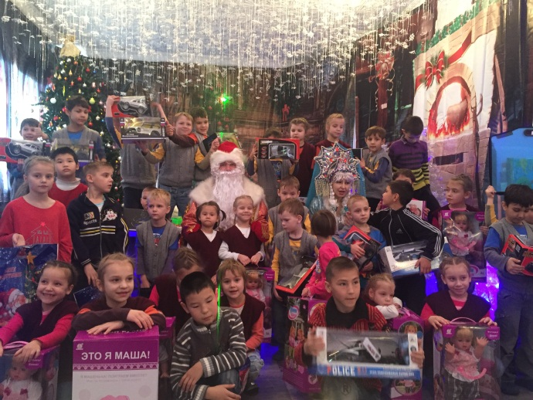
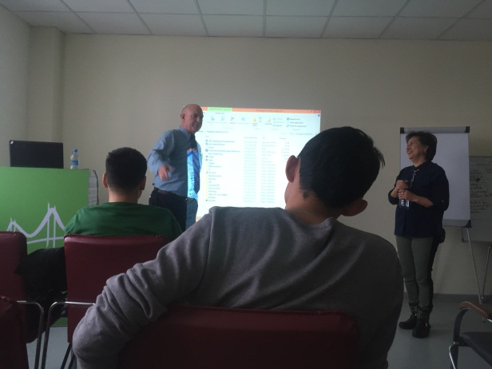
AMCHAM CSR WORKING GROUP
Successful Amcham CSR Group projects:
“From Recycling to Donation” project.
Earth Day Clean-Up.
Letter to Ded Moroz (Santa Claus) project..
A series of master-classes to the students of MOST business incubator (young entrepreneurs).

Slide 7
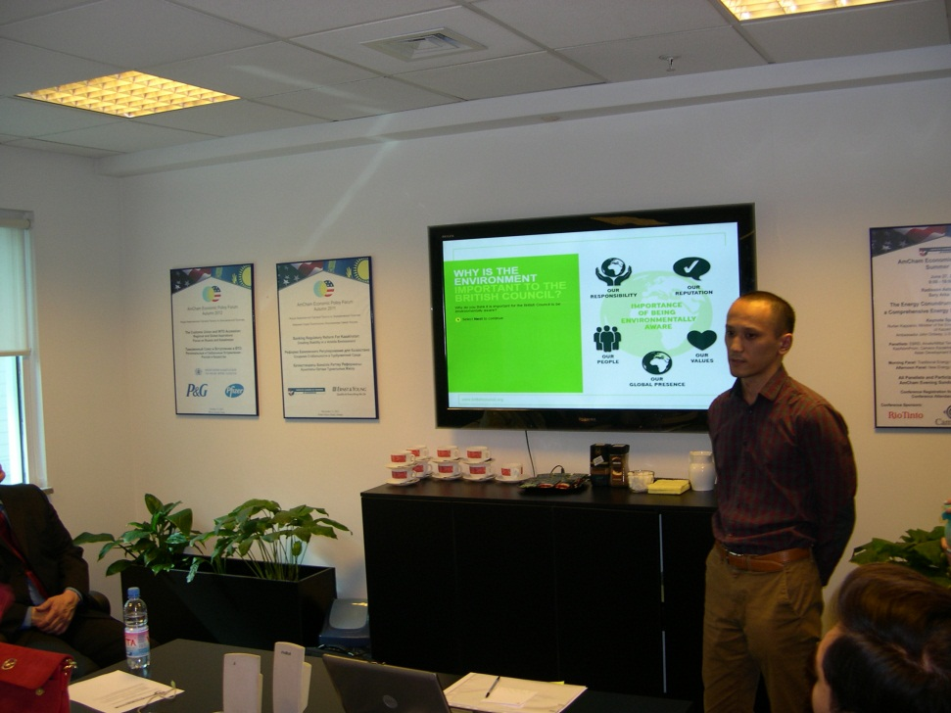

AMCHAM CSR WORKING GROUP
AmCham CSR WG meetings are a great platform not only for discussion, but also for setting contacts. Companies learn more about projects of other organizations and establish joint projects.
Moreover, it is a place where various local NGOs and funds can find partners. It should be noted that companies can participate in a way that wasn’t necessarily financial. For example, they can do it through a volunteer and time given system.

Slide 8


