Slide 1
Export Considerations and Importance of contract in bilateral Trade
By: Manizha Paktin
28 – June – 2016, Almaty - Kazakhistan
E-Mail: manizha.paktin@gmail.com
Phone: +77089899520

Slide 2
Export Promotion Agency of Afghanistan
EPAA is an executive arm of the Ministry of Commerce and Industry and was established in 2006.
Lobbying for simplification of export procedures & taxes
Promote Afghanistan export
Advising and advocacy for exporters‘ right
Provide Capacity and tailored made trainings for exporters

Slide 3
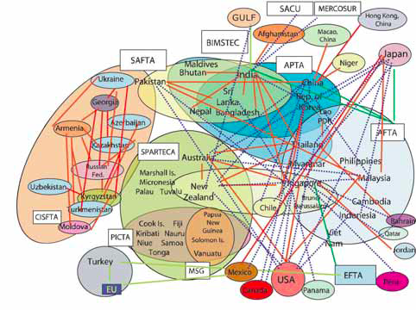
Economic benefits for region and beyond
Asia noodle bowl of preferential trade

Slide 4
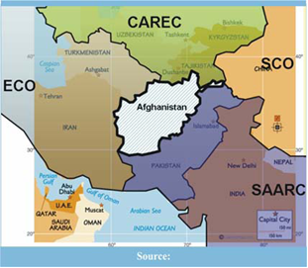
Afghanistan from a Landlocked to Land linked country
Bridging Central and South Asia and further accession to TIR, CBTA and TRACECA MLA.
Member of ECO, CAREC and SAARC

Slide 5
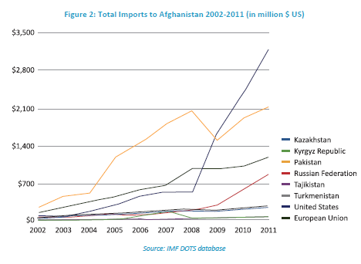
Regional Trade Dynamics

Slide 6
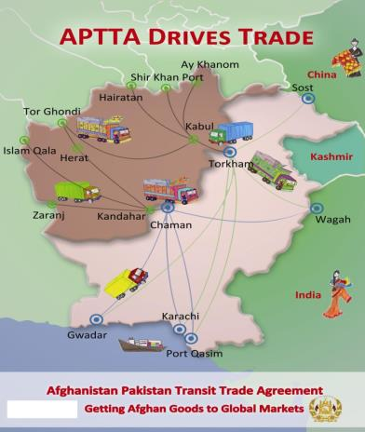
Afghanistan–Pakistan Transit Trade Agreement (APTTA)
1965 Agreement ATTA replaced by APTTA signed on Oct, 2010 and enforced on 12th June 2011.
Facilitating Transit Trade for Afghanistan and gateway for Pakistan for the transit trade to Central Asia.
Afghanistan gains access to Indian and Chinese markets via access to seaports and land crossing points

Slide 7
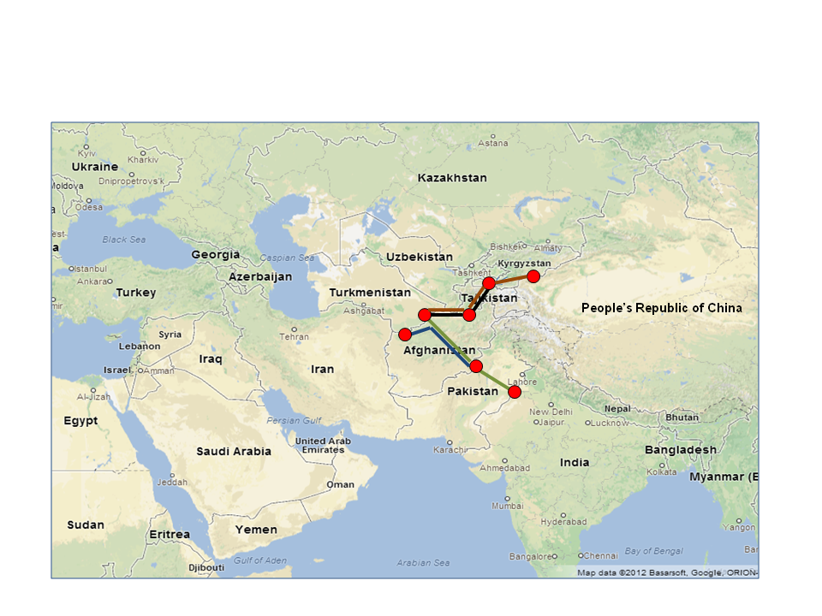

Slide 8
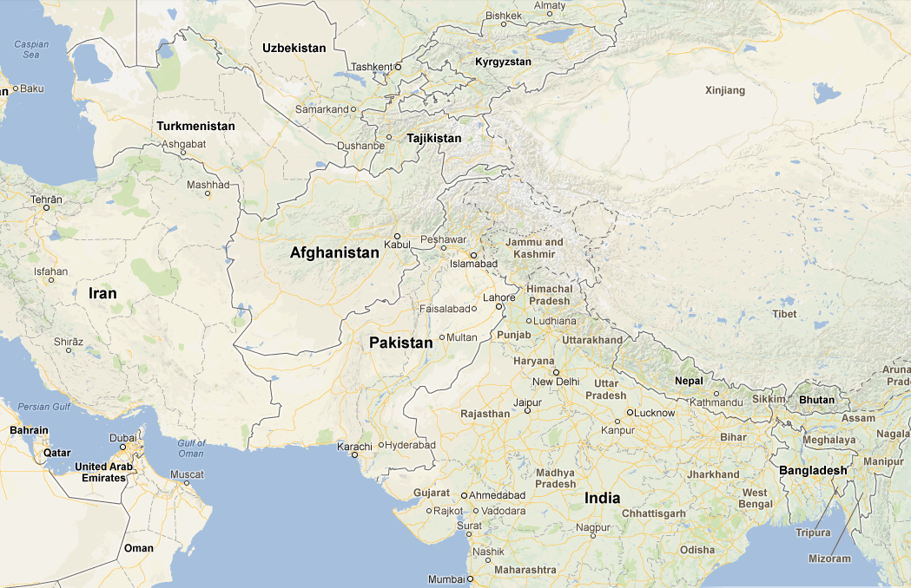
For Example: Most commercially viable transit routes for Afghanistan for Turkmen trade in future
Kazakhstan
People’s Republic of China
Notes:
There are specific actions that can be resolved quickly –for example the Uzbekistan bridge where non ethnic Uzbek carriers have difficulty.
There are also big actions that will take longer but have a very large benefit. For example the link through Afghanistan from Turkmenistan transit trade to/from India and Pakistan and China have big benefits.
This will provide the key link between Central Asia and the fast growing south Asian region The TAPI pipeline will also be of large benefit. The construction cost of the pipeline, will involve more than US 8 billion dollars.

Slide 9
Export Statistics 2002- 2014

Slide 10
Key Export Sectors
Carpets
Dry Fruits and Nuts
Handicrafts and jewelry
Raw & Processed Fresh Fruits and Vegetables
Natural Herbs and Medicinal Plants
Gemstones

Slide 11
Key Export Sectors and % of contribution

Slide 12
Afghanistan exports to…
Afghanistan Trade Statistics 2012 - CSO

Slide 13
Export legal Considerations
Export Registration
Export Procedures
Tax Duties
Environmental Protection Agency Restrictions
Notes:
Exporters are frequently faced with legal issues, such as those relating to agent/distributor agreements, protection of intellectual property rights and appropriate licensing arrangements, which can determine the viability of a successful export transaction. Here are some other legal issues:

Slide 14
Role contracts of International Contracts in bilateral Trade
Issues
Solutions
Buyer insolvency
Non- acceptable
Credit Risk
Regulatory Risk
Intervention
Political Risk
War and uncontrollable Events
Contracts
Tarrifs
Revenue Tariffs
Protective Tariffs
Generalized Systems of Preferences
Bilateral Agreements

Slide 15
Women and Export
Women in Afghanistan who want to enter trade or maintain or expand their business are faced with a broad range of issues in every aspect of their lives and thus there are limited women part of the exporting sector which is a men dominated sector.
Economical Activities
Carpet and Handicraft
Natural Herbs
Dried Fruits

Slide 16
Thank You
Manizha Paktin
E-Mail: manizha.paktin@gmail.com
Phone: +77089899520

Slide 17
Stand Up Afghan Women

Slide 18
Cractrestic
NGOs are not created to generate personal profit. Although they may have paid employees
and engage in revenue-generating activities they do not distribute profits or surpluses to
members or management;

Slide 19
there is usually NGOs are voluntary.
This means that they are formed voluntarily and that an element of voluntary participation in the organization;

Slide 20
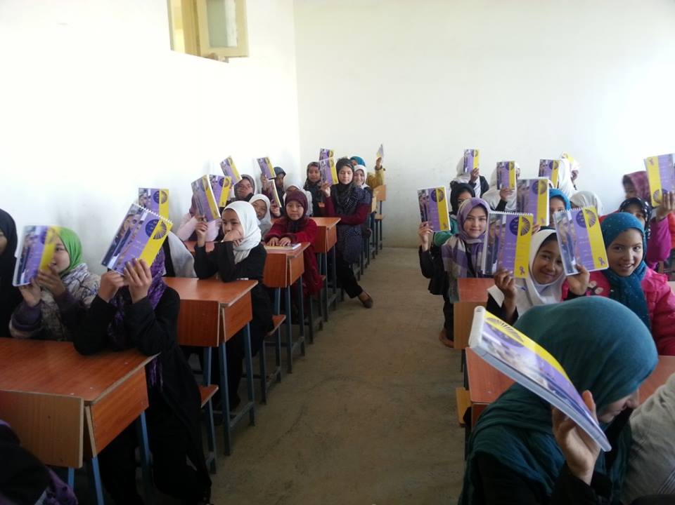

Slide 21
NGOs are distinguished from informal or ad hoc groups by having some degree of formal
or institutional existence. Usually, NGOs have formal statutes or other governing document
setting out their mission, objectives and scope. They are accountable to their members and
donors;

Slide 22
Promote project/ USID

Slide 23
NGOs are independent, in particular of government and other public authorities and of political parties or commercial organizations;

Slide 24
NGOs are not self-serving in aims and related values. Their aim is to act in the public arena at large, on concerns and issues related to the well being of people, specific groups of people or society as a whole. They are not pursuing the commercial or professional interests of their members.

Slide 25
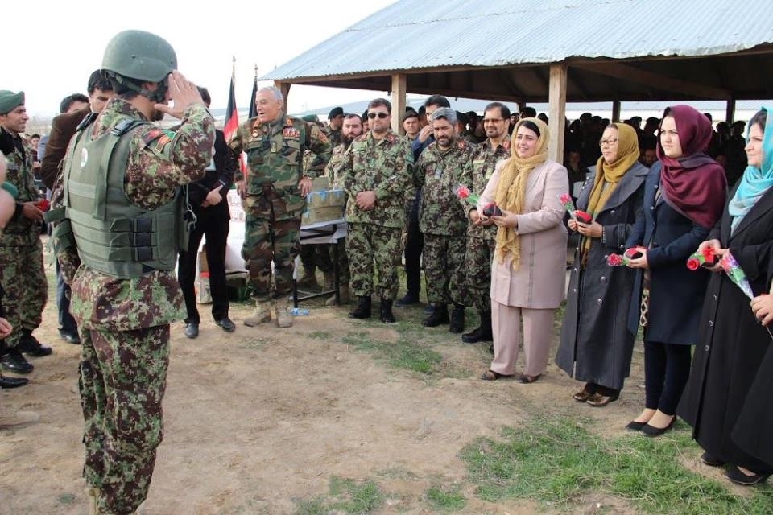

Slide 28
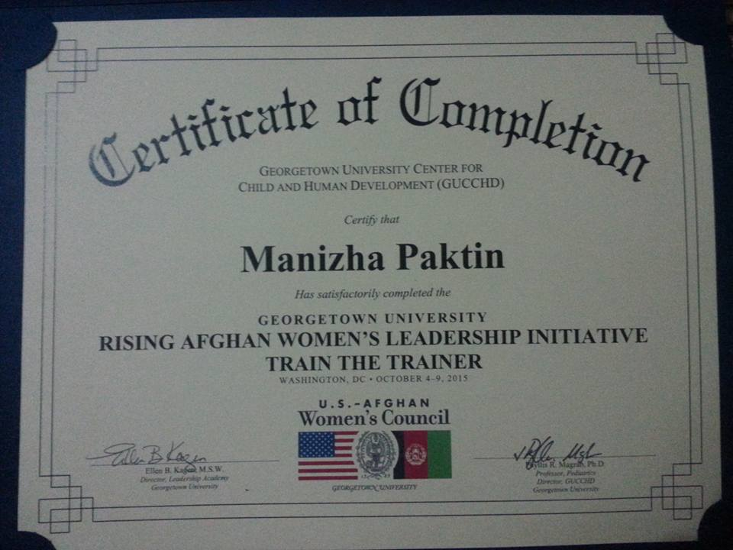

Slide 29
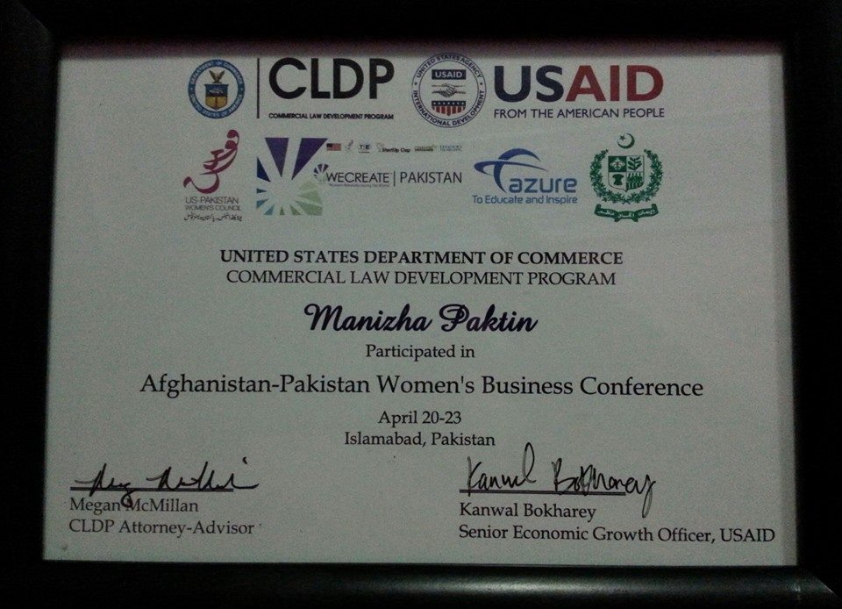

Slide 31
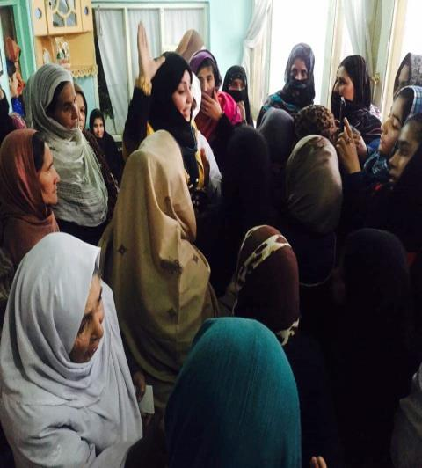

Slide 32
