Slide 1
Social Media Analytics
13 June 2018
Almaty, Kazakhstan
Insights into Development Conference

Slide 2
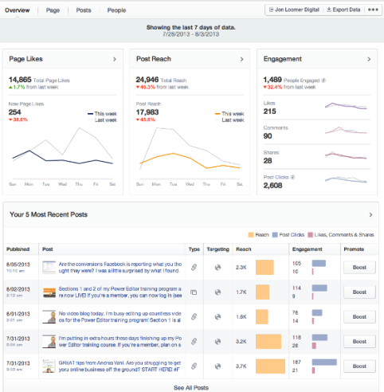
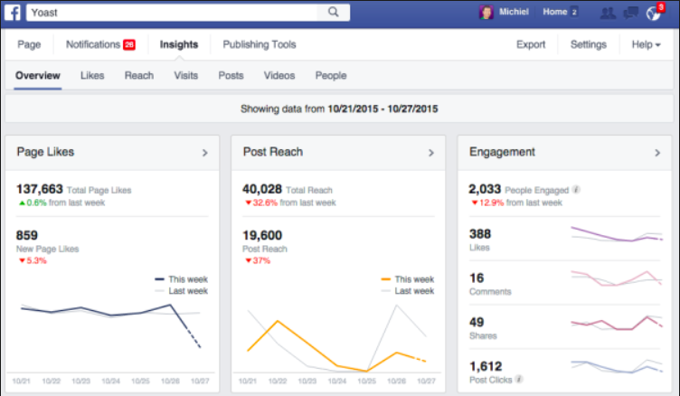
Facebook Insights
Notes:
Hub Objectives
The overall objective of Innovation pour le Changement Afrique is to protect, respect, strengthen, expand and recover civil society space.
More specifically, the objectives are to:
Develop and sustain an interactive and easy to use online resource centre essential to the campaign for the opening and maintaining of civil society space.
Provide rapid support and legal analysis of regulations, administrative decisions and referrals for individuals or organizations in Africa.
Improve the ability of civil society to mobilise and provide solidarity to countries or individuals affected by closing civic space
Facilitate and coordinate alliance building among networks and relevant organizations across Africa and beyond
Grow and sustain the Hub’s position as a continental platform for protecting and expanding civic space in Africa.
Communication Objectives
To build the online community to 100 users minimum by the time of the public launch in September with representation across all regions and posts contributed in English, French, Portuguese, and Arabic.
To develop a donor, private sector, social business and innovation partner ecosystem.

Slide 3
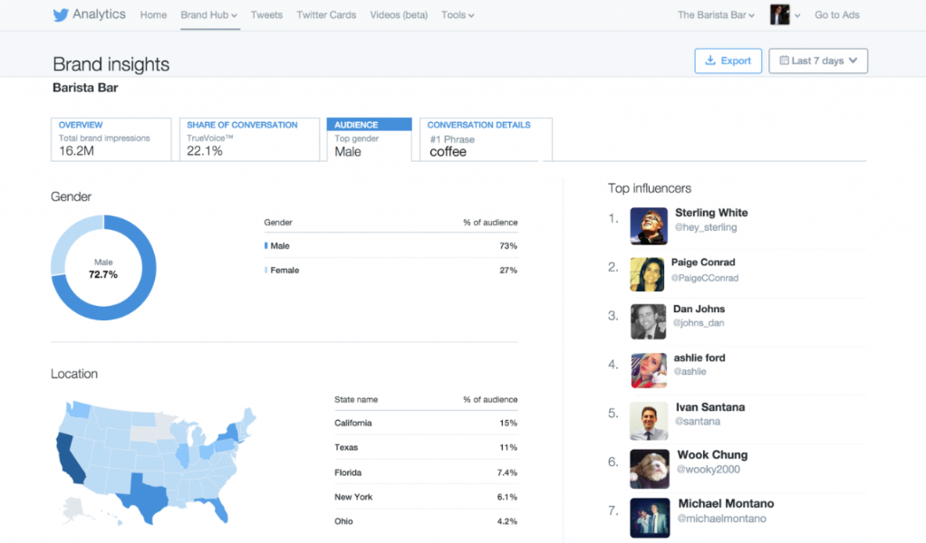
Twitter Insights
Notes:
Hub Objectives
The overall objective of Innovation pour le Changement Afrique is to protect, respect, strengthen, expand and recover civil society space.
More specifically, the objectives are to:
Develop and sustain an interactive and easy to use online resource centre essential to the campaign for the opening and maintaining of civil society space.
Provide rapid support and legal analysis of regulations, administrative decisions and referrals for individuals or organizations in Africa.
Improve the ability of civil society to mobilise and provide solidarity to countries or individuals affected by closing civic space
Facilitate and coordinate alliance building among networks and relevant organizations across Africa and beyond
Grow and sustain the Hub’s position as a continental platform for protecting and expanding civic space in Africa.
Communication Objectives
To build the online community to 100 users minimum by the time of the public launch in September with representation across all regions and posts contributed in English, French, Portuguese, and Arabic.
To develop a donor, private sector, social business and innovation partner ecosystem.

Slide 4
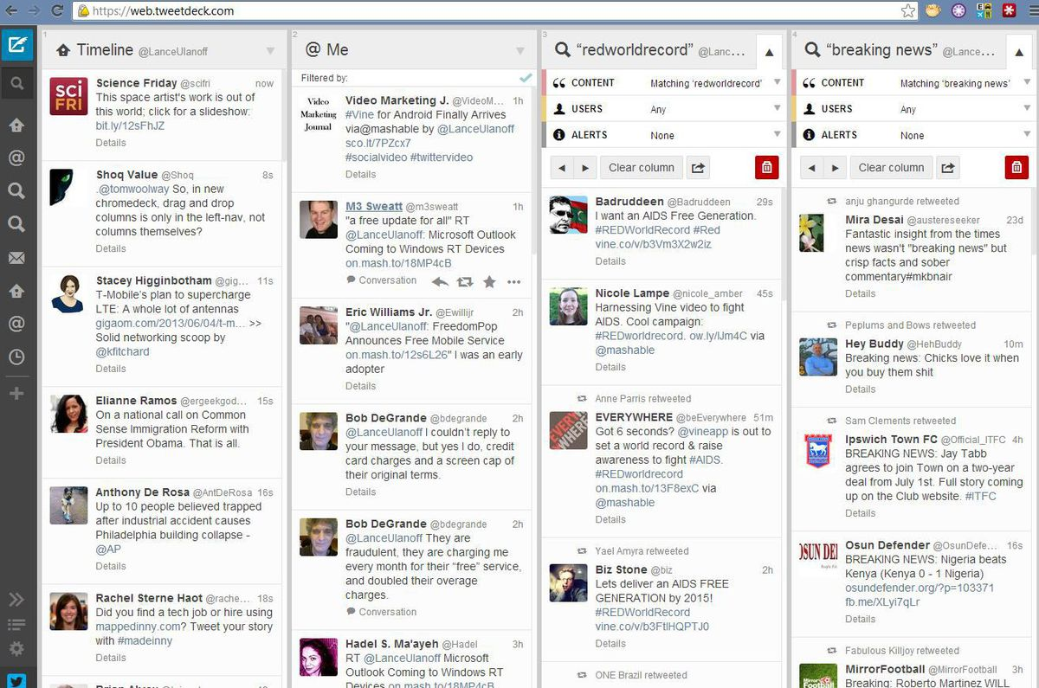
TweetDeck
Notes:
Hub Objectives
The overall objective of Innovation pour le Changement Afrique is to protect, respect, strengthen, expand and recover civil society space.
More specifically, the objectives are to:
Develop and sustain an interactive and easy to use online resource centre essential to the campaign for the opening and maintaining of civil society space.
Provide rapid support and legal analysis of regulations, administrative decisions and referrals for individuals or organizations in Africa.
Improve the ability of civil society to mobilise and provide solidarity to countries or individuals affected by closing civic space
Facilitate and coordinate alliance building among networks and relevant organizations across Africa and beyond
Grow and sustain the Hub’s position as a continental platform for protecting and expanding civic space in Africa.
Communication Objectives
To build the online community to 100 users minimum by the time of the public launch in September with representation across all regions and posts contributed in English, French, Portuguese, and Arabic.
To develop a donor, private sector, social business and innovation partner ecosystem.

Slide 5
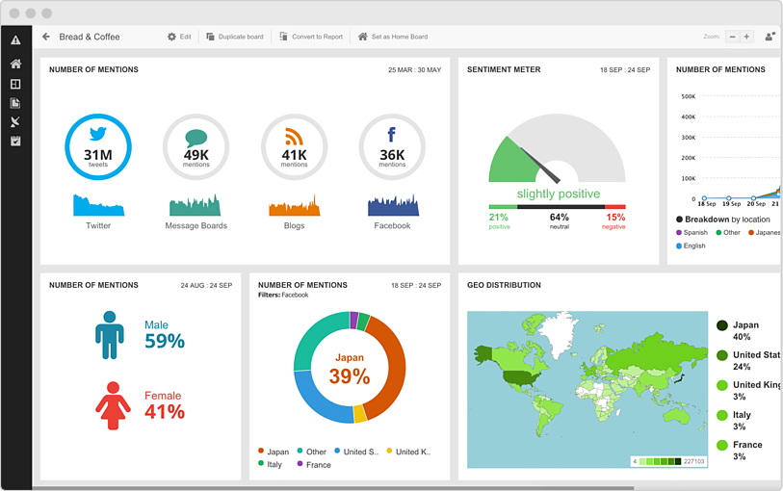
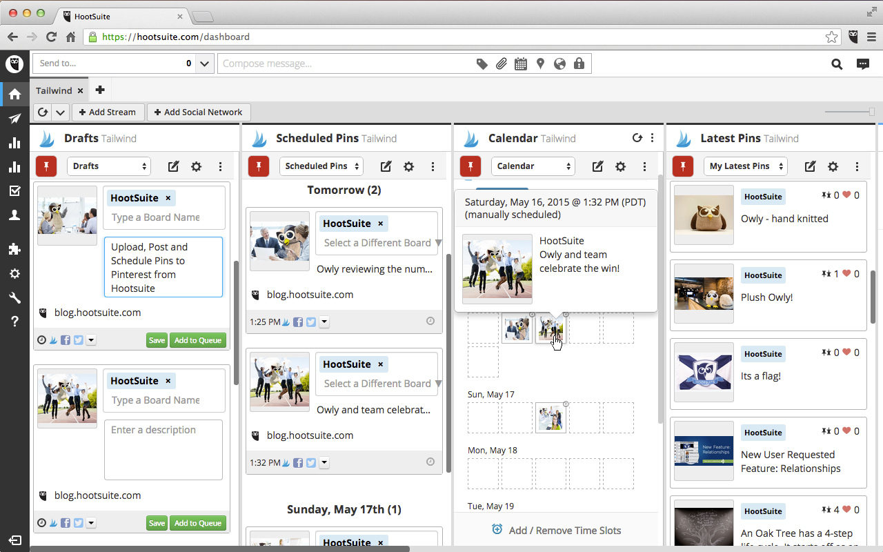
HootSuite
Notes:
Hub Objectives
The overall objective of Innovation pour le Changement Afrique is to protect, respect, strengthen, expand and recover civil society space.
More specifically, the objectives are to:
Develop and sustain an interactive and easy to use online resource centre essential to the campaign for the opening and maintaining of civil society space.
Provide rapid support and legal analysis of regulations, administrative decisions and referrals for individuals or organizations in Africa.
Improve the ability of civil society to mobilise and provide solidarity to countries or individuals affected by closing civic space
Facilitate and coordinate alliance building among networks and relevant organizations across Africa and beyond
Grow and sustain the Hub’s position as a continental platform for protecting and expanding civic space in Africa.
Communication Objectives
To build the online community to 100 users minimum by the time of the public launch in September with representation across all regions and posts contributed in English, French, Portuguese, and Arabic.
To develop a donor, private sector, social business and innovation partner ecosystem.

Slide 6
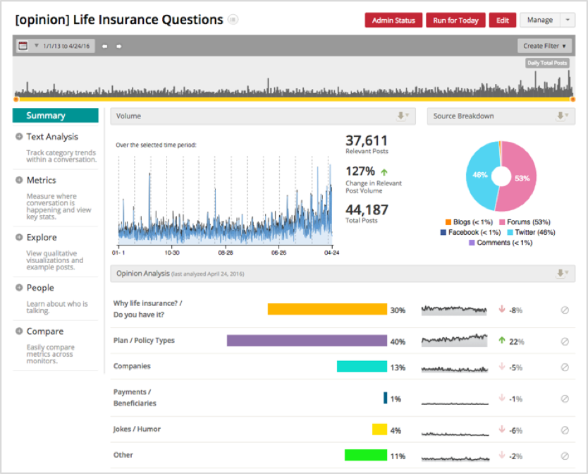
Crimson Hexagon
Notes:
Hub Objectives
The overall objective of Innovation pour le Changement Afrique is to protect, respect, strengthen, expand and recover civil society space.
More specifically, the objectives are to:
Develop and sustain an interactive and easy to use online resource centre essential to the campaign for the opening and maintaining of civil society space.
Provide rapid support and legal analysis of regulations, administrative decisions and referrals for individuals or organizations in Africa.
Improve the ability of civil society to mobilise and provide solidarity to countries or individuals affected by closing civic space
Facilitate and coordinate alliance building among networks and relevant organizations across Africa and beyond
Grow and sustain the Hub’s position as a continental platform for protecting and expanding civic space in Africa.
Communication Objectives
To build the online community to 100 users minimum by the time of the public launch in September with representation across all regions and posts contributed in English, French, Portuguese, and Arabic.
To develop a donor, private sector, social business and innovation partner ecosystem.

Slide 7
Questions?

Slide 8
Thank you!!!
If you have any other questions, don't hesitate to email ellie@innovationforchange.net
Visit https://innovationforchange.net/toolkit/introduction-to-social-media-analytics/ for the toolkit
Notes:
Notes for Katie:
This section includes:
How we can help – essentially outlining the various levels of help we have provided for each region and leading into how we can help them going forward (not too in depth on this though as we'll touch on this at the end of this first part when we go over the monthly content package.
2 slides per region with 1. hub objectives and comms objectives/strategy and 2. each regions communications work plan (tables I will be putting together with key dates and comms outputs surrounding them). at the beginning of this session, we will also clearly articulate that because for most regions we developed these in coordination with the POCs and with the information in the draft strategies, they are in no way solid or complete. for that reason we will be having open office hours throughout the IRR. Please meet with Katie, Adi, or Ellie to schedule a time to discuss any shortcomings/additions you may have either during lunches/breaks or Thursday 3-6 during Regional Work Plan development
Tell them about our plan to provide the whole group with monthly content packages (something Adi and I had talked about – like a monthly pre launch promo kit for the whole group and not just the comms people so they can share and promote the platform in their networks on social media, etc) – I also was thinking about this this morning. The first thing to include in this is a branding list. not like the guide, though we should include that too, but a what to call your hub what not to call your hub. acceptable twitter handles etc.
At the end we'll pass out flyers they can share along with extra pens they can hand out. we need to draft a flyer lol. maybe just print that shitty infographic i did?

