Slide 1
Maintaining Organizational Resiliency in the 21st Century Civic Space:
Tailored Support to Build Civil Society Acumen and Transparency

Slide 2
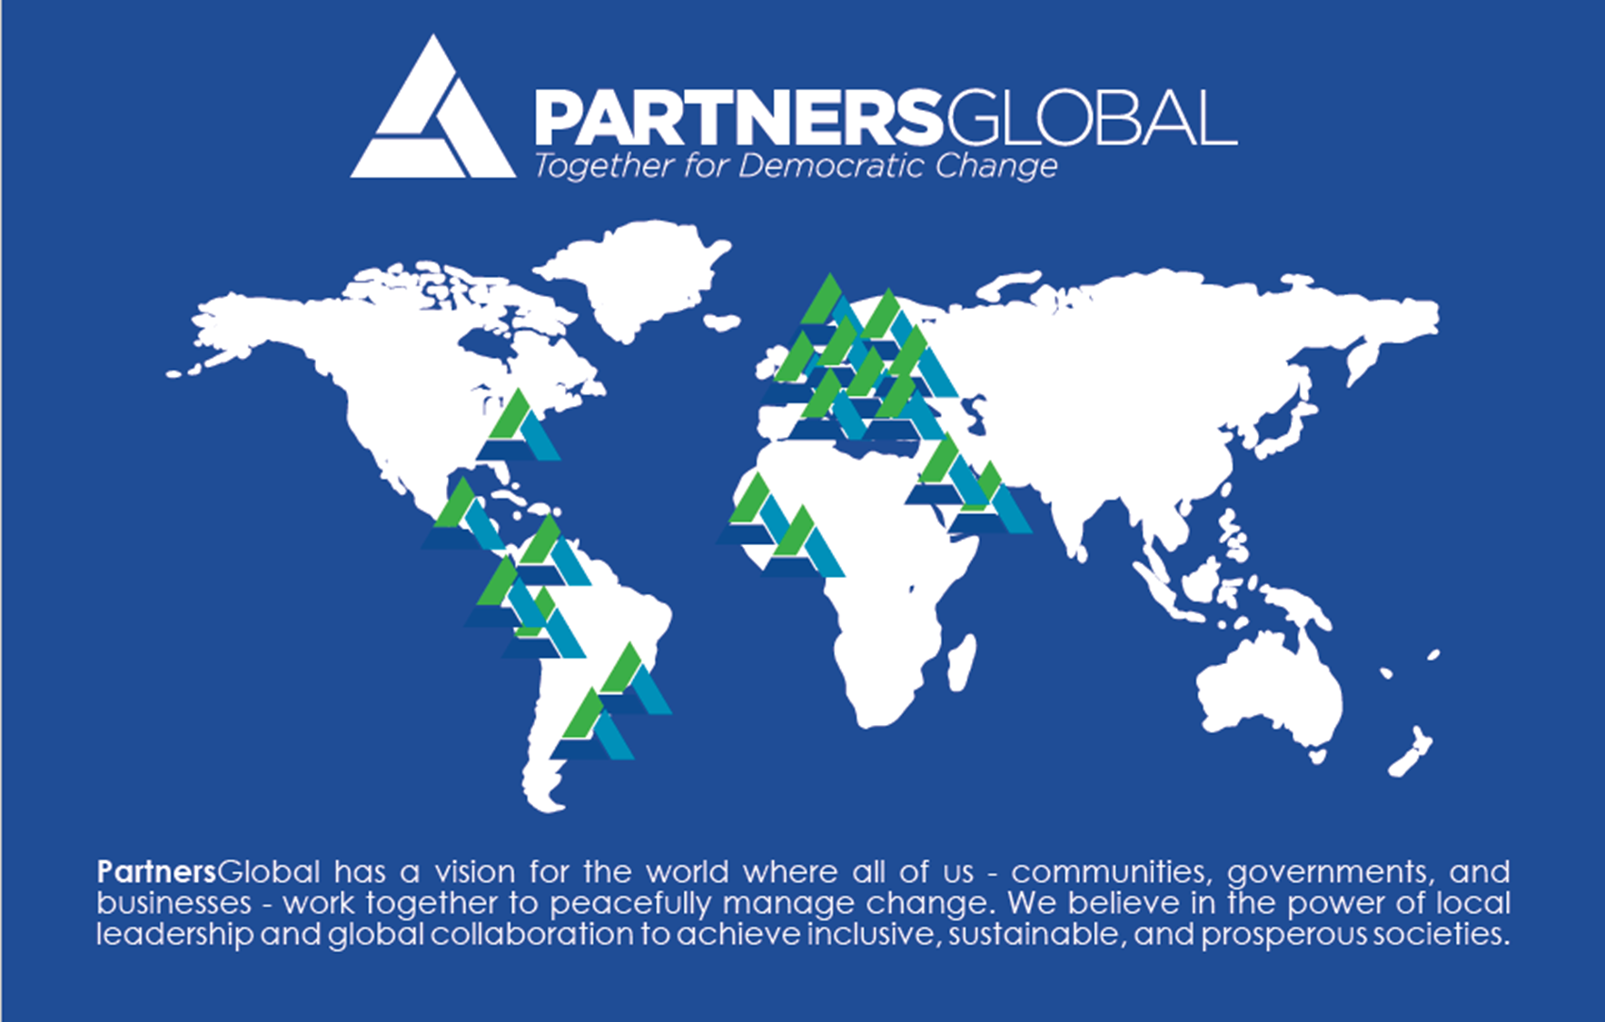
The Partners Network
Over the past 26 years, PartnersGlobal has worked as a driving force investing in and maintaining our 21 affiliate centers active in 54 countries around the world using a unique brand of entrepreneurial and sustainable development aimed at CSO’s and CSO networks.
Our support to CSO longevity responds to needs at all stages of an organization’s lifecycle. We recognize that CSO’s both benefit and thrive when they are able to incorporate basic building blocks of entrepreneurial thinking to build resiliency into their business models.

Slide 3
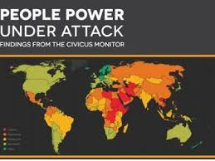
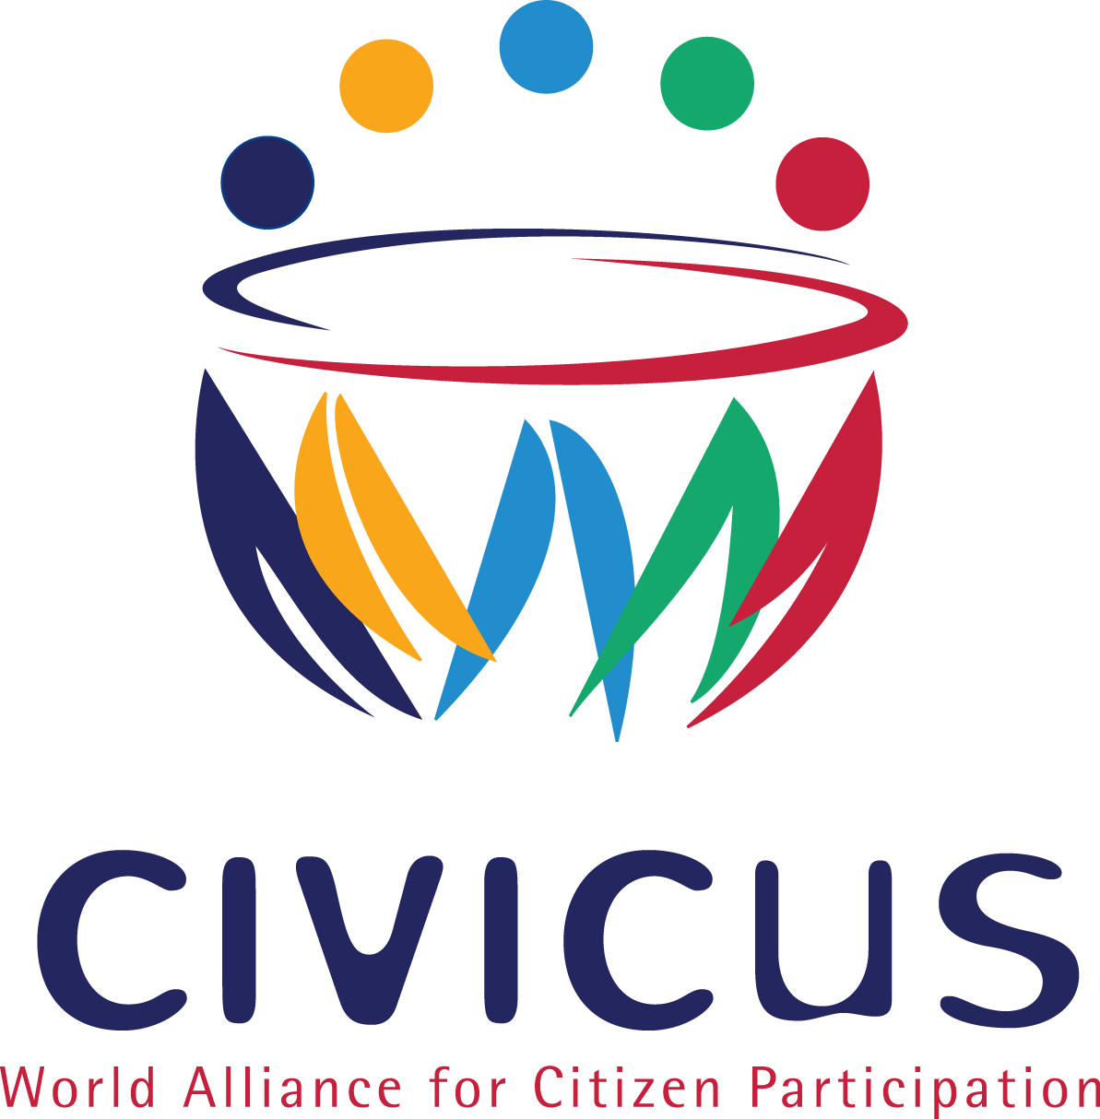
CIVICUS / Partners GLOBAL Alliance
CIVICUS and PartnersGlobal are “truth testing a comprehensive civil society strengthening process to increase organizational resilience in the face of closing political spaces worldwide
Our initial intervention is focused within our combined Networks, with the idea of testing and refining a comprehensive process
This design and testing phase will explore a variety of formats for the content and assets to be used, shared and disseminated

Slide 4
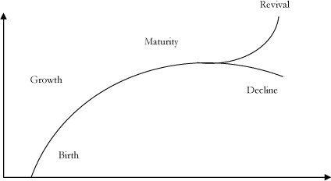
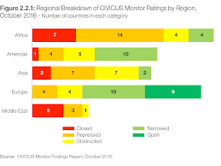
21ST CENTURY ACUMEN
OUR FRAMEWORK COMBINES ADVANCED ORGANIZATIONAL STRENGTHENING ACROSS AN ORGANIZATION’S LIFECYLE
+
INTENSIVE, INTEGRATED TECHNIQUES , RESOURCES AND CONNECTIONS TO PREVENT AND COUNTERACT CLOSING CIVIC SPACE

Slide 5
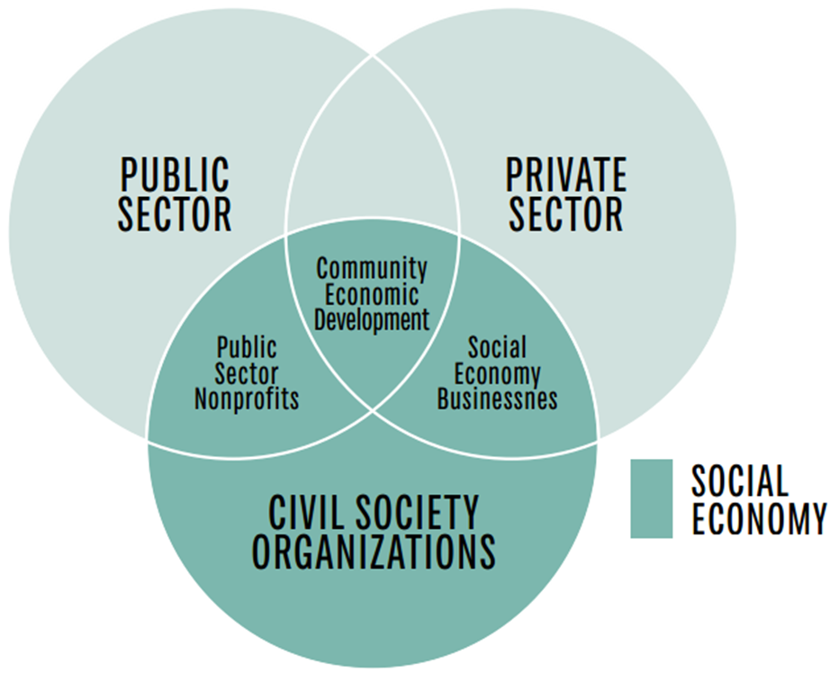

Organizational Resiliency for civil society under threat
There is growing trend to direct donor resources toward rising social movements and to reduce resources for well-established CSO’s. Ironically, this shrinking of funding and space is occurring at a time CSO’s are most needed in their communities to defend democratic values.
Rather than limiting funding to civil society capacity building, donors have the opportunity to meet civil society where their needs are and provide new types of capacity building support, which includes programs to develop entrepreneurial thinking and resiliency.

Slide 6
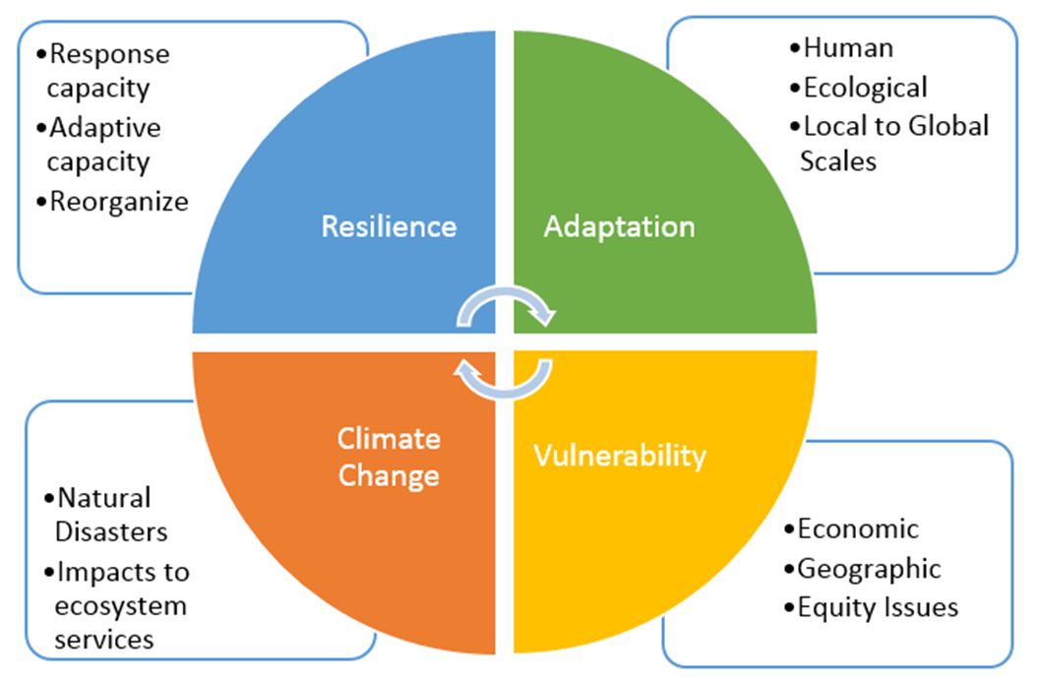
Revenue Diversification and Entrepreneurial Mindset development
According to our network affiliates, the most important factor for resiliency and long-term sustainability is revenue diversification and the development of an entrepreneurial mindset that supports the organization’s mission.
Rather than changing a business model, CSO’s should work to establish an entrepreneurial mindset, which incorporates the refinement of valuable professional and life skills into their current model and focuses on a business-oriented approach.

Slide 7
The Partners Approach: Organizational Support Interventions
Organizational Resiliency requires a sustained long-term customized relationship between peer leaders and their CSO clients to periodically assess and diagnose threats, nurture innovation and maintain trust in our sector.
Our approach embodies a set of cross-functional life and professional skills that open up new paths for CSO’s to see and seize opportunities, marshal resources efficiently and create value as they develop an entrepreneurial mindset. Our team of experts, all existing or past NGO leaders, works directly with leaders and organizations to put entrepreneurial skills into practice to enhance their capacity to be strong, successful and resilient.
PREDICTIVE AND RESPONSE TACTICS
to weather shock of disruptions
ENTREPRENEURIAL MINDSET
To prevent organizational stagnation and decline
STRATEGIC COMMUNICATIONS
To raise the value and credibility of the civil society community
ALLIANCES
to develop coordinated responses to closing space

Slide 8

PartnersGlobal RESILIENCY +
Entrepreneurial Acumen for 21st Century Civic Action
ADAPTABILITY
to a rapidly changing environment
INNOVATION
in programming
LEADERSHIP
accompaniment and care
RADICAL TRANSPARENCY
to increase trust
PARTNERSHIP
strategies for leverage
BUSINESS MODELLING
for independence
COLLECTIVE ACTION
through sophisticated tools
LEGACY ORGANIZATION
accompaniment – field office to local NGO

Slide 9
Phase 1:
Awareness
This phase includes orientation to the NGO Renewal and Turn-Around Process in which perspective NGO clients learn about methodology, engagement principles and goals in order to succeed as an organization.
      PartnersGlobal presents the organizational lifecycle
      Participants complete a preliminary self-assessment
      Case studies are shared from PartnersGlobal Network Turn-Around interventions

Slide 10
Phase 2:
Renewal – Assessment and prescriptive interventions
#2. Contextual Analyses and Desk Research
#1. NGO Leadership Team Consultation with Renewal Team Lead
#3. Conduct External Assessment
#4. Conduct Staff Assessment
#5. Recommendations of Next Steps
#6. Report and Launch of Accompaniment

Slide 11
Phase 3:
Accompaniment and peer Follow-On Support
Link staff to PartnersGlobal Network of peer mentors to assist with challenges related to implementation of “renewal action”
Develop timeline for check-ins with Renewal Team to support unanticipated challenges in implementing “renewal action”
Provide access to PartnersGlobal Organizational Strengthening Capacity Building Modules
Access Renewal Team as mediators in the even of conflict arising from Renewal process

