Slide 1
Todogood – an intellectual volunteering platform
Join us!

Slide 2
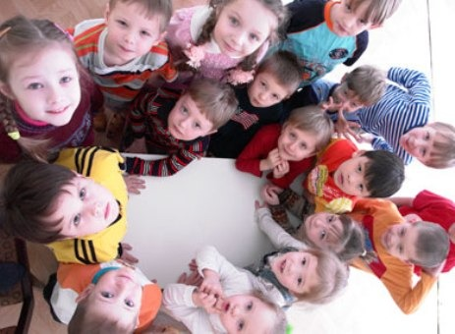
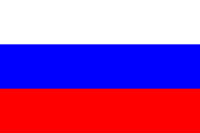
Charity organizations in Russia are currently incapable of addressing major social issues
Charity sector today: small and fragmented organizations ...
... collecting insufficient funds, given the scale of the country
... why? No trust
15 NGOs hold ~ 60% of the children charity market, the remaining 40% fall to > 2,000 organizations
Only 7 organizations have a budget > RUB 100M, only 3 of them have ~ RUB 1B
The majority of players are regional organizations
Country
% of GDP
Management focus on program activities, rather than development
Shortage of highly skilled personnel in regions
No resources to obtain quality services
5.5%
4.0%
2.3%
0.9%
But YOU and us can change it.
Together.
1. According to the Ministry of Justice data

Slide 3
Todogood is a ready-made thought-out solution; each party is interested to be involved
Achievement of the company's CSR, HR, PR objectives
Enhanced staff motivation and loyalty to the employer
Nurturing of corporate culture and communication of values
Staff teambuilding
Personal contribution to addressing acute social problems
Self-realization in a new environment
Development of soft skills
Community of like-minded people
Companies
Employees
Todogood
Getting professional help for further development
Development of own competencies
Strengthening of relations with business
Todogood’s mission is to create a community of new business leaders capable of addressing large-scale social challenges
Social sector

Slide 4
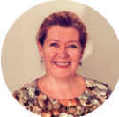
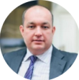
Our partners and their impressions of cooperation with us
"Todogood's initiative helps NGOs to find professionals who are able and willing to support the funds in addressing their business challenges. We plan to continue cooperating with todogood, and right now we are preparing several new requests "-
Irina Ryazanova, Executive Director of "Bolshaya Peremena” (“Big Change”) Charity Fund
“Engagement of intellectual volunteers and cross-functional interaction in a project mode represent a real change driver for the fund. We are not just seeing improvements right here and now - we are even more looking forward to seeing a delayed effect of our cooperation” - Andrei Konstantinov, Commercial Director of “Starost v Radost” (“The Joy of Old Age”) Charity Fund

Slide 5
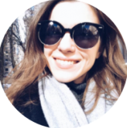
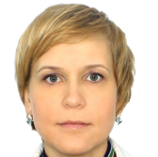
Our community of volunteers and their impressions
“My involvement in the project has given me the confidence that many challenges may be addressed, and the courage to keep going toward these goals"- Alexander Rachinina , McKinsey&Company
“Professional development, a chance to broaden my horizons, new relations and meeting interesting people, a sense of involvement in something vital" - Lyubov Trunina, KROK

Slide 6
Projects involving todogood are closely linked leading companies’ HR policy and CSR strategy
HR policy
CSR
Enhancement of staff loyalty thanks to the emergence of an additional way of self-realization
Development of soft skills thanks to gaining hands-on experience in implementing a consulting project
Strengthening of horizontal links in the company thanks to a new experience of cross-functional collaboration
A new format of staff involvement in charity work - a long-term personal contribution
A real and visible contribution to the development of NGOs corresponding to the CSR policy
An opportunity to combine assistance formats - CSR budget and human capital investments in the development of NGOs

Slide 7
Todogood – platform of the social changes
Over 50 pro bono projects since 2016
200+ hours of pro bono projects
3+ mln USD invested into social sector in human capital resources
300K+ USD fundraised for the social sector
ME TOO
Project managers assisting to smoothly organize project work
Methods and models based on best global practices
Coaches assisting to develop competencies
Meeting and presentation facilities
Design of extremely complex slides for a final presentation of the project
Support
600+ professionals - todogood community
More than 150 volunteers willing to share their experience and impressions
38 NGOs, social entrepreneurs and state organizations launched new projects and competences
Projects
Community

Slide 8
Join us: you choose the participation format, the topics and NGOs yourself
Format 1
Team-building event
Format 2.
Staff
development program
Description
Addressing a relevant strategic case for an NGO within the framework of one event
Implementation of real consulting projects for social organizations
Example tasks
Selection of a route forward, new ideas for raising funds, financial model, etc.
Fundraising strategy, operating model, overall NGO strategy, etc.
Target audience
A large group of employees of different levels – specialists, managers
Limited teams with appropriate professional experience: 3-5 persons (middle management)
Basic proposal
Standard: 1 business day
Optional: 1-3 days
Standard: 3 months, ~5 nonworking hours per week
Optional: 2-6 months
Duration
Todogood’s role
Organization of events and activities
Facilitation, moderation of teams
Potential combination with training
Facilitation, potential assignment of a professional project leader
L&D program: trainings and coaching
Expected result
Teambuilding, group training, addressing a social problem, identifying a soft skills development need (test in action)
Assistance to NGOs, training in leadership and teamwork models, solving and communication problems in the context of the best consulting companies, teambuilding
We will develop together with you a customized leadership and skills development program for your staff depending on the overall corporate strategy, as well as HR and CSR objectives

Slide 9
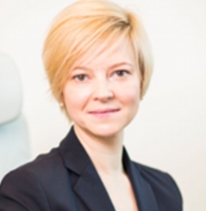
The programme works successfully – example L&D program of todogood and J&J
Feedback of Janssen’s Director
Staff development program
2 parallel projects:
"The Joy of Old Age” Charity Fund: “Development of a communication strategy” (proposed by todogood)
“Aga Khan Foundation": “Development of materials for a series of workshops” (proposed by company management)
2 four-person teams (all in all 8 persons)
Middle managers and specialists
A structured L&D program:
Group trainings: “Personal growth", "Leadership"
"Communication skills” group coaching
Individual coaching over the course of the project
“If you say "yes” to opportunities, then they appear... Involvement in intellectual volunteering also gives impetus to development. For example, our company has joined the todogood platform... For an employee, this is an opportunity to participate in a development program where he will be able to share his experience and to gain a new one." - a quote from an interview with Catherine Pogodina, Janssen’s Director (pharm. division of Johnson & Johnson) for ForbesWoman magazine

Slide 10
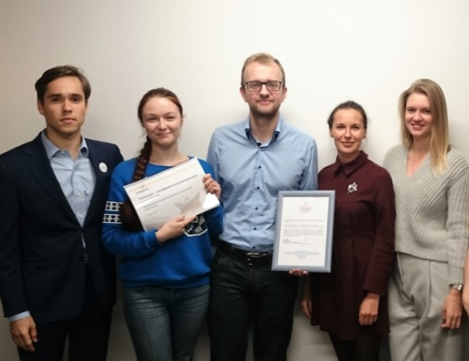
Case study: Fund-raising strategy development
Project context
What we did
Expected results
A Fund for targeted care for children with oncology diseases in the Russian Federation and CIS and their families, as well as project assistance to RAMS Blokhin Russian Cancer Research Center Hospital
Unstable dynamics of attracting charitable contributions, the need for a liquidity "cushion"
Sporadic operational activities, lack of streamlined business processes and a KPI system
Fundraising strategy adapted to the needs of the Fund, and a phased plan for attracting charitable contributions
Guidelines for priority donor category management
External presentation for corporate partners
Budgeting model
Twofold increase in charitable contributions
(from RUB 50M to 100M) in 2017 as a result of:
Complete restructuring of the Fund's work with corporate partners,
Optimization of the Fund's work with private donors,
Introduction of two new members to the Fund's Supervisory Board upon recommendations;
Building up professional reputation as a cornerstone of future development
Volunteers
Nikolai Mukhin (Team Leader)
Director, IR, VTB Bank
Anna Tishchenko
Chief Marketing and Communications
Officer, YADRO
Elena Ustinova
ССС Manager, Philips
Nikita Zhilin
Founder, Homeapp
Project duration:
15 weeks

Slide 11
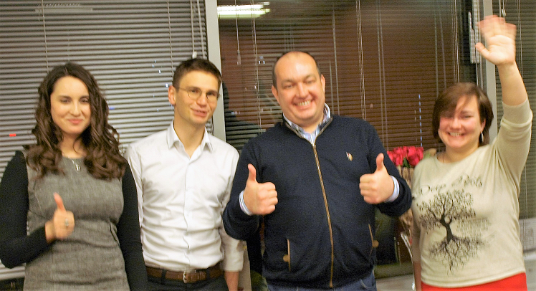
Case study: Development of operational improvements and elaboration of a fund-raising development strategy
Project context
What we did
Expected results
The largest Russian fund for project and targeted assistance for the elderly and disabled people
The past 5 years have seen a growth in the volume of funds raised (~ 70% per annum), however the inflow of funds is unsystematic and unsustainable
Absence of any fundraising strategy, KPI system or well-established business processes; the operating activity is spontaneous
Segmentation of donors, passports for priority categories (big companies, mass individual donors, wealthy individual donors)
A roadmap and fundraising strategy implementation tools, including: a database of companies, presentation materials, KPI system metrics, commercial offer templates
A development plan for the fund-raising function
A report on the Fund’s sustainable development
Achievement of sustainable development and improvement of fund-raising figures based on the Fund’s development strategy (~ RUB 41M in 2015, RUB 64M in 2016, RUB ?M in 2017)
Implementation of operating activity tools, including: a KPI system, a CRM system, templates of materials and reports.
Volunteers:
Project duration:
08.08.16 – 28.10.16 (12 weeks)
Valentin Lavrentiev (Team Leader)
Senior BCG consultant
Georgy Roppelt
McKinsey & Company consultant
Anna Baryshnikova
Specialist in registration and certification
of Philips medical products
Ekaterina Tumanova
BCG Recruitment Department coordinator

Slide 12
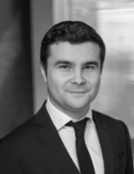
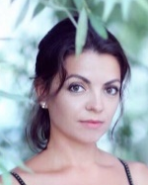
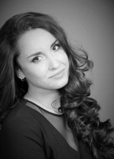
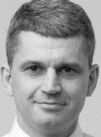
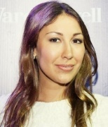
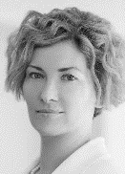
Todogood Team
We believe that everyone should do what he or she loves to do and really knows how to do it. And we invite volunteers to apply their professional skills while working on projects involving the most flamboyant funds and organizations.
Anton Stepanenko, BCG
Founder
Overall Management
Anna Tishchenko, Marketing & communications
Maria Zalunina, NGO management and Marketing
Elena Suvertok,
Volunteer Projects Leader
Project facilitation
Community management
Selection of volunteers for projects
Selection of NGOs and projects
Oleg Chirkov, MGIMO
L&D Coach & Designer Soft Skills Trainer
Leysen Shayakhmetova, Corporate programs,
L&D Coach & Designer
Yulia Smyslova Moscow Government MSU
Corp. programs, facilitation
Olga Kiryukhina Deloitte
Corp. programs, facilitation
Marketing & communications
Corporate programs: L&D programs and case days

Slide 13
See you on todogood projects!

