Slide 1
9th INTERNATIONAL CONFERENCE INSIGHTS INTO DEVELOPMENT – ALMATY - KZ BEYOND STEROTYPES; RESEARCH BASED ADVOCACY AS INNOVATIVE APPROACH Afghanistan Case study 13th June 2018 Ehsan Shayegan

Slide 2
PRESENTATION OUTLINE Overview CASE – AFGHANISTAN Research Finding Presentation Impacts

Slide 3
OVERVIEW:
What do we mean by research based advocacy? Advocacy based on a systematic study to influence the formal and informal policies established by government/ state in support of marginalized social group/ groups. Again the policy can have a broad meaning such as Agendas/policy horizons; Official statements or documents; Patterns of spending (government budget); Implementation processes and Activities on the ground.
It became a useful approach during the last decade (Western Countries, Africa ‘East Africa’ and South Asia).
In Afghanistan, Huge amount of money (Millions of Dollars), spent in 15 years but wasted in following Traditional Advocacy Approach (Stereotypes and general information).
It resulted in, ineffective advocacy and lack of basic advocacy literature after almost 16 years. PRSO Tried a different approach for the first time in 2016.

Slide 4
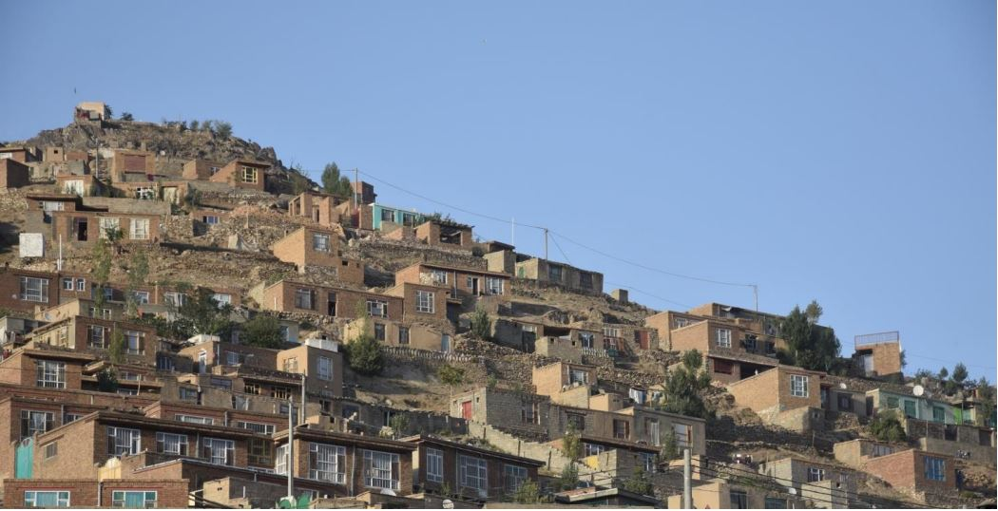
In 2016, PRSO established, “Research for Informed Decision Making”, 2nd Voluntary study (Leishmaniasis Outbreak in Kabul, District # 13) at a highly deprived area (Ettifaq Town) (10,000 household). Disease spread here in 2014, but no one; neither government, nor any NGO have paid attention to them.
Notes:
1- One of the first voluntary project was, a study on a highly deprived community in remote area of Kabul city, named Shahrak Etifaq (Ettifaq Town).

Slide 5
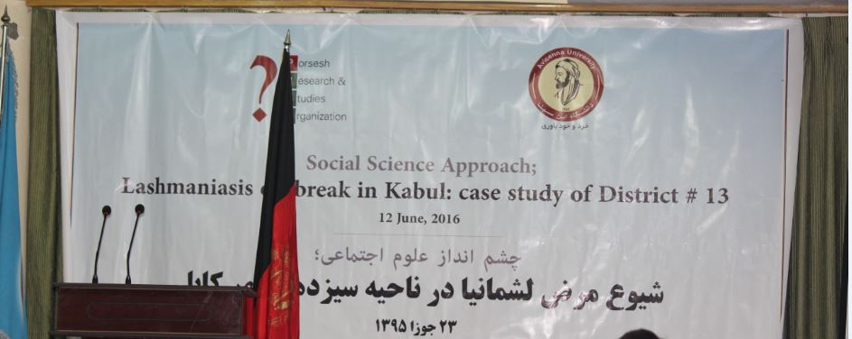
RESEARACH FINDING PRESENTATION: - Representative of Ministry of Public Health - Media - Civil Society Organizations - Research Institutions - Community Representatives - Health NGOs Representatives
Result: Diseases had catastrophic and disastrous impacts which was widely spread. In average 2 individual per family was effected, Big scars (1- 22).

Slide 6
IMPACTS: - Resulted in hot debate between government, civil society organizations and media (Q & A Session) - Took wide coverage by Media, Started asking Governement (2014 – 2016) - Government Installed a mobile Clinic (4 Male and Female Doctors), Distributed more than 7000 family net - 4 Doctor volunteered to work in that hospital for four months. - Health NET TPO, Visited the area, implemented Public Awareness Campaign and Training on primitive prevention measures - Private hospitals were established
BUT, study conducted voluntarily in 2017, government, no preventive measures, Took the mobile clinic out! WHY? Because they were not constantly overlooked by CSOs and Advocacy Organizations
LESSONS LEARNED
1- Research as integrated part – Program
2- Take a position, Policy Brief 3- Form a working advocacy group from among the relevant organization for the constant follow up

Slide 7
Thank you Complete research reports of 2016 & 2017 is available at; www.porseshresearch.org

