Slide 1
Becoming Tech Savvy How and When to Use Technology
Noel Dickover
Counterpart International

Slide 2
Questions
When is technology effective?
When is technology not useful?
What are some best practices for technology use?
How can I plan a successful technology implementation?

Slide 3
Common technology implementation mistakes

Slide 4
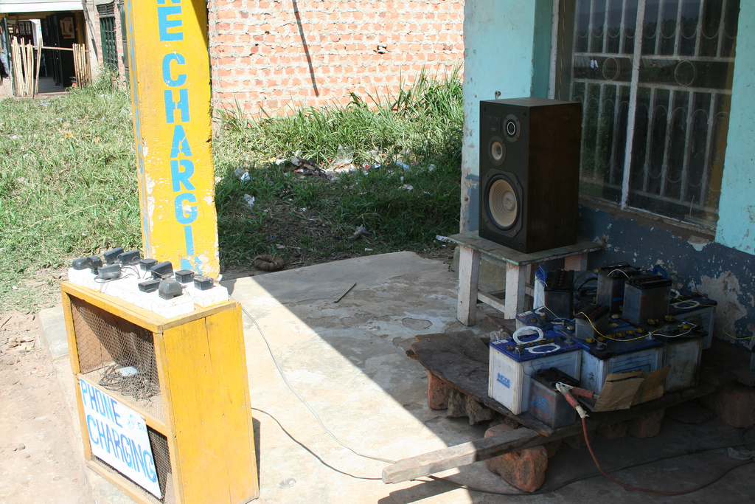
Technology doesn’t work in your context
http://www.flickr.com/photos/kajisagook/3911589441

Slide 5
Shiny Object Syndrome

Slide 6
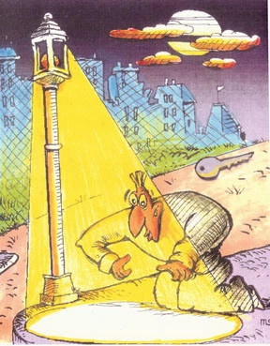
Tool Myopia
Buying what you know,
not what you need

Slide 7
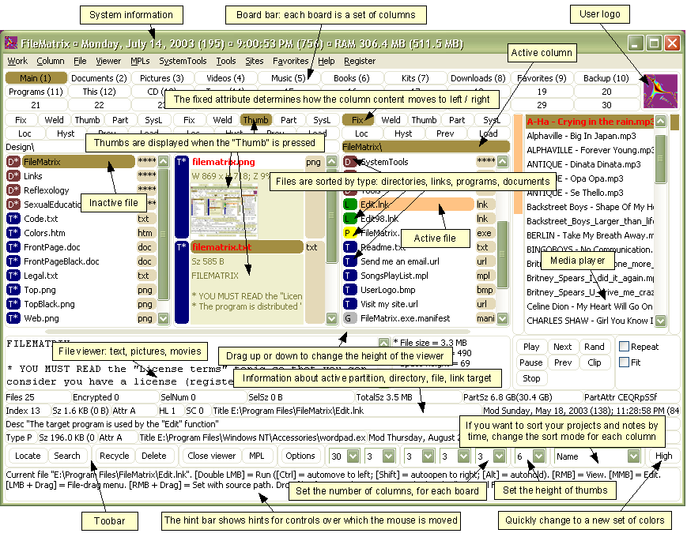
Complicated Interface,
poor usability

Slide 8
Poor vendor support

Slide 9
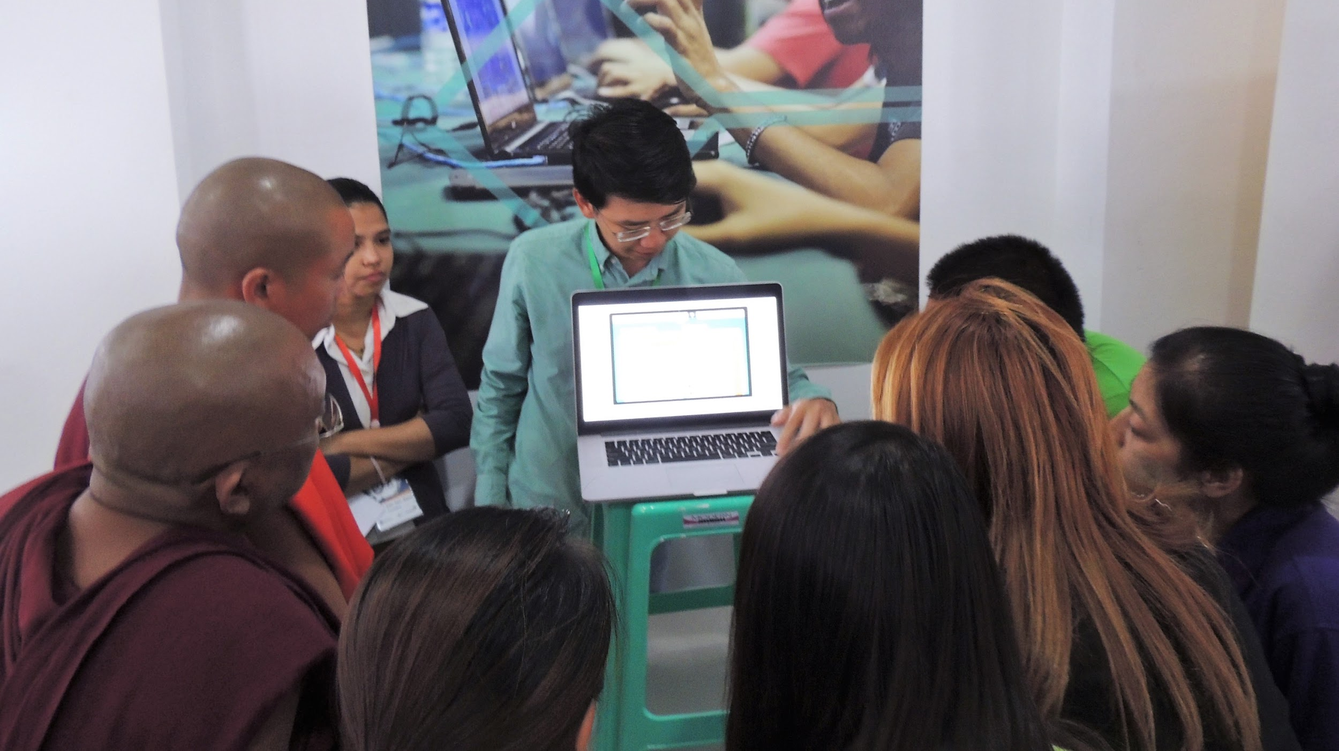
Training and support not included

Slide 10
Team not in place

Slide 11
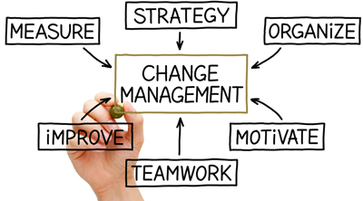
No Change Management Plan

Slide 12
Problems technology is good at solving

Slide 13
Communication challenges

Slide 14
Knowledge sharing, Mass collaboration

Slide 15
Building online communities

Slide 16
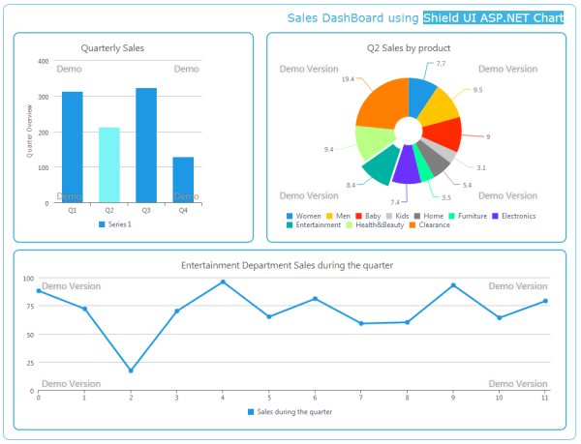
Data aggregation and visualization

Slide 17
Location

Slide 18
Online training and support

Slide 19
Content creation, dissemination

Slide 20
Outreach and engagement

Slide 21
Problems technology cannot help with

Slide 22
Solving power dynamics

Slide 23
Determining your goal

Slide 24
Building Trust

Slide 26
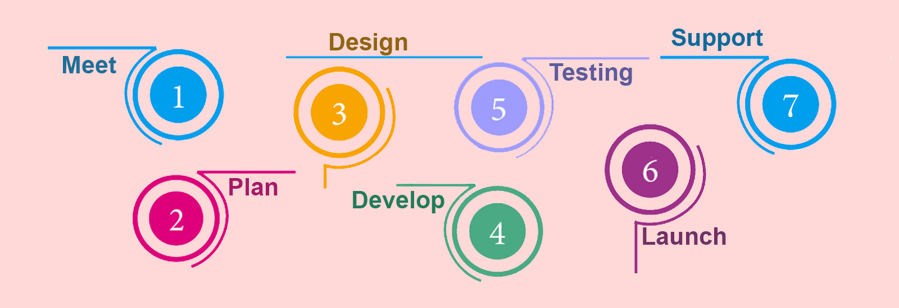
Determining your work process

Slide 27
Planning a technology implementation
Goals and objectives
Scope
Context
Budget and timelines
Team in place
Analysis of alternatives
Map out the process (before purchasing the IT)
Change management plan

Slide 28
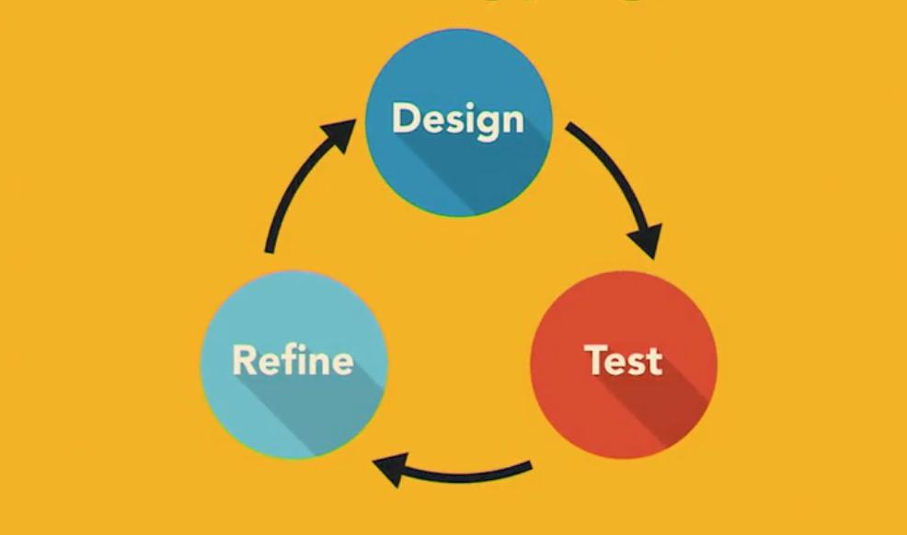
P
Prototyping Process

Slide 29
Prototyping
Can be done with paper
Messy is good
Testing
Show prototype with potential users
Come up with a set of open-ended questions to validate prototype
Leverage existing tools
Iterate multiple times until you are satisfied

Slide 30
Team structure
Project manager
Technical lead
Communications
Change management lead
Test and evaluation, usability

Slide 31
Questions for choosing a technology vendor partner
Clear language: Do they use jargon to confuse you?
Personalized approach: Have they personalized their approach to your needs? Are your concerns reflected?
Appearance of the proposal: Does the proposal look good or have lots of errors?
Specifics: Did the vendor provide specific, tangible recommendations?
References: Does the vendor have good references of previous work?

Slide 32
Engage with the local tech community!
Understand local technology and telecommunications use
One-to-many connection between technologists and civil society sectors
Some cities have disconnected tech “pockets”
Tech for social good events should
Overtly connect different communities
Make the technologists as the stars
Bake in youth
Long term engagement and interaction

Slide 33
Noel Dickover Project Director, Innovation for Change Counterpart International ndickover@counterpart.org @noeldickover

