Slide 1
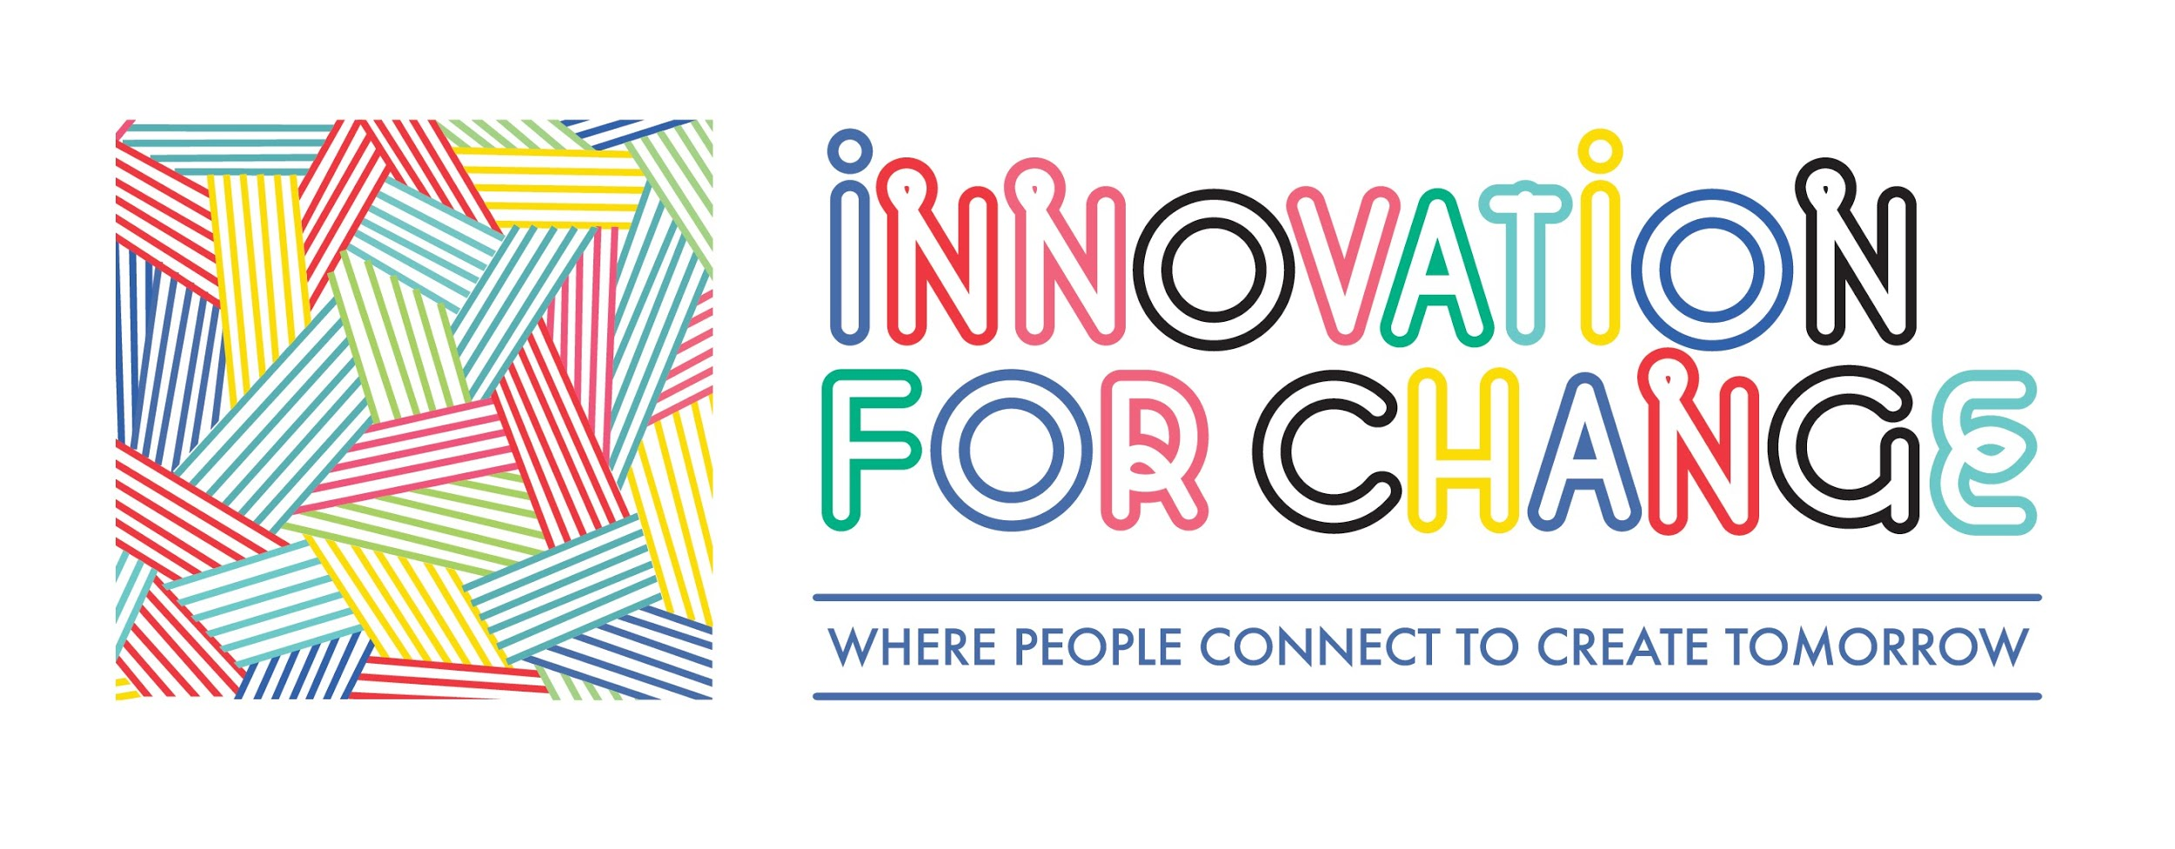
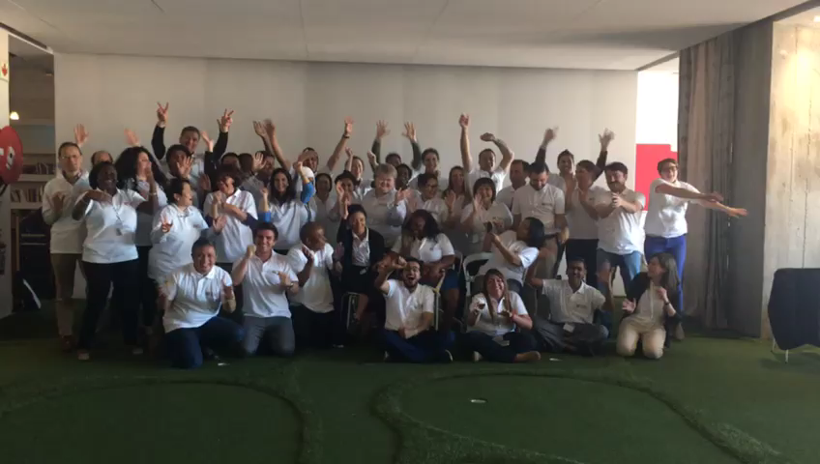
Innovation for Change (I4C) is a global network of people and organisations who want to connect, partner and learn together to defend and strengthen civic space and overcome restrictions to our basic freedoms of assembly, association and speech.
We are a community-led network inspired by ideas, methods, and technologies from across different sectors. We work together on advocacy, research, network building, education and training, fundraising, digital literacy and technology development.
Our seven connected regional hubs are growing in both physical and online spaces across Africa, Central Asia, East Asia, the Pacific, Latin America and the Caribbean, the Middle East and North Africa and South Asia. Here, people exchange ideas and share their successes, challenges and opportunities in incubating social change and building sustainable solutions.

Slide 2
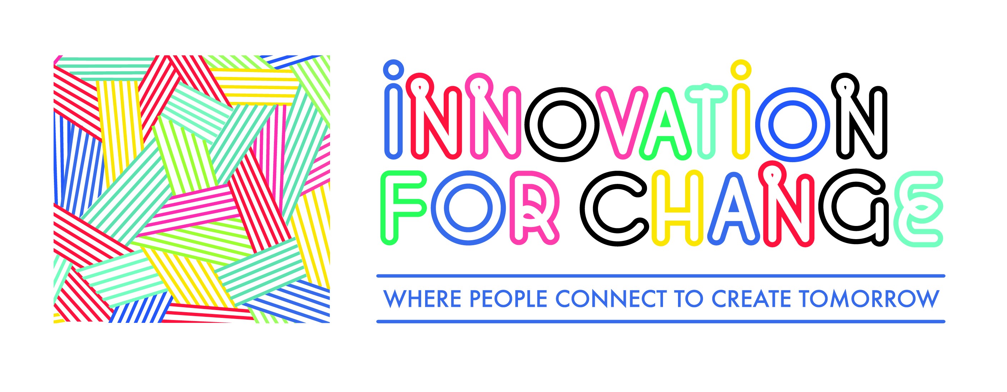
Innovation
What is Innovation?
NEW SOLUTION IN A NEW CONTEXT | ESTABLISHED SOLUTION IN A NEW CONTEXT
NEW SOLUTION IN ESTABLISHED CONTEXT | ESTABLISHED SOLUTION(S) RECOMBINE TO SERVE AN OBJECTIVE

Slide 3
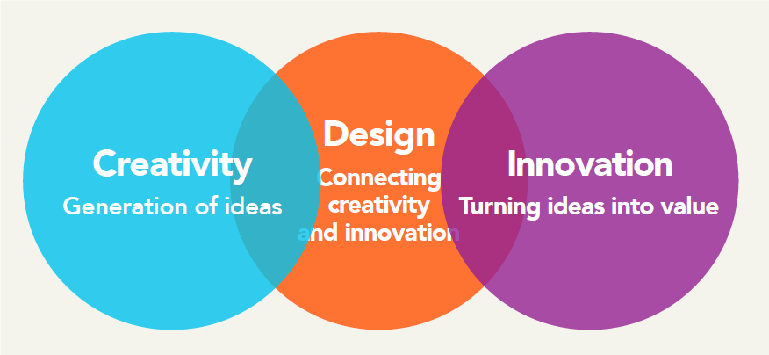

Slide 4
DESIGN THINKING
“Design thinking is a human-centered approach to innovation that draws from the designer's toolkit to integrate the needs of people, the possibilities of technology, and the requirements for success.”

Slide 5
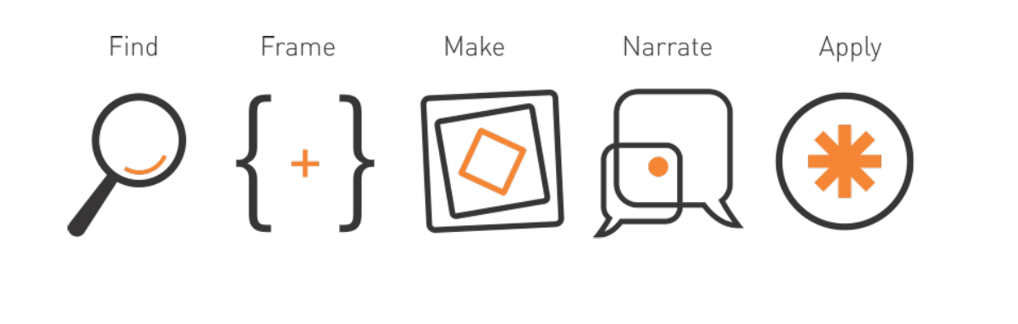

Slide 6
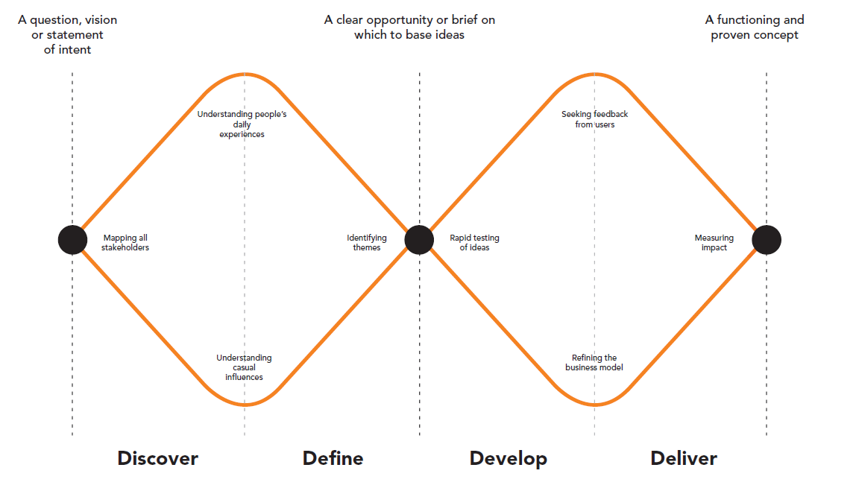

Slide 7
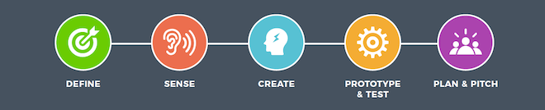

Slide 8
Design Thinking Exercises
Defining a vision
Framing
Problem diagram
Context map
Persona
Customer journey
Empty your brain
Idea prioritisation
Protoyping & testing

Slide 9
Framing

Slide 10
Problem Diagram

Slide 12
Context Map

Slide 13

Persona
Persona | Behaviour | Attitude
Identity | Goals | Quotes

Slide 14
Customer Journey
 |  |  |  | Time
Context
Behaviour
Emotions Quote
Job/Activity
Journey Stage
Touch points
Opportunities
Needs
Barriers

Slide 15

Any questions? Resources?
Email: cecily@innovationforchange.net

