Slide 1
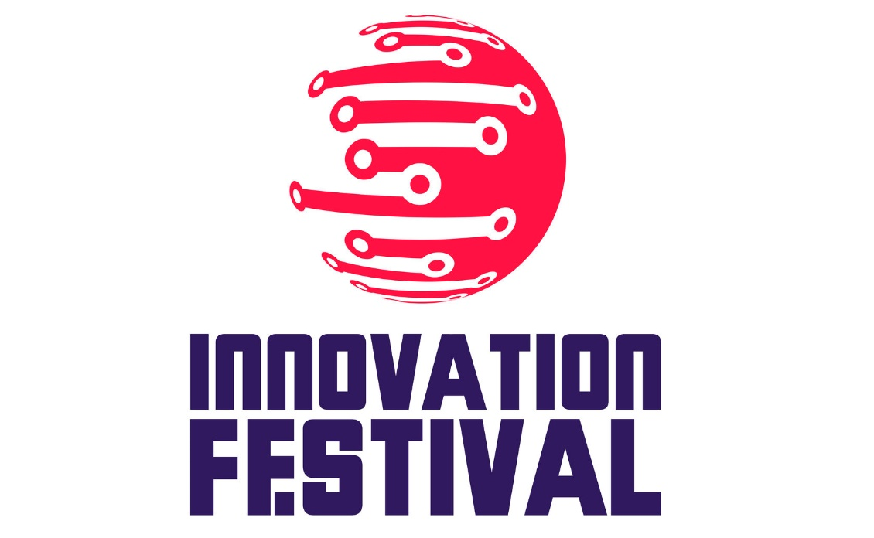
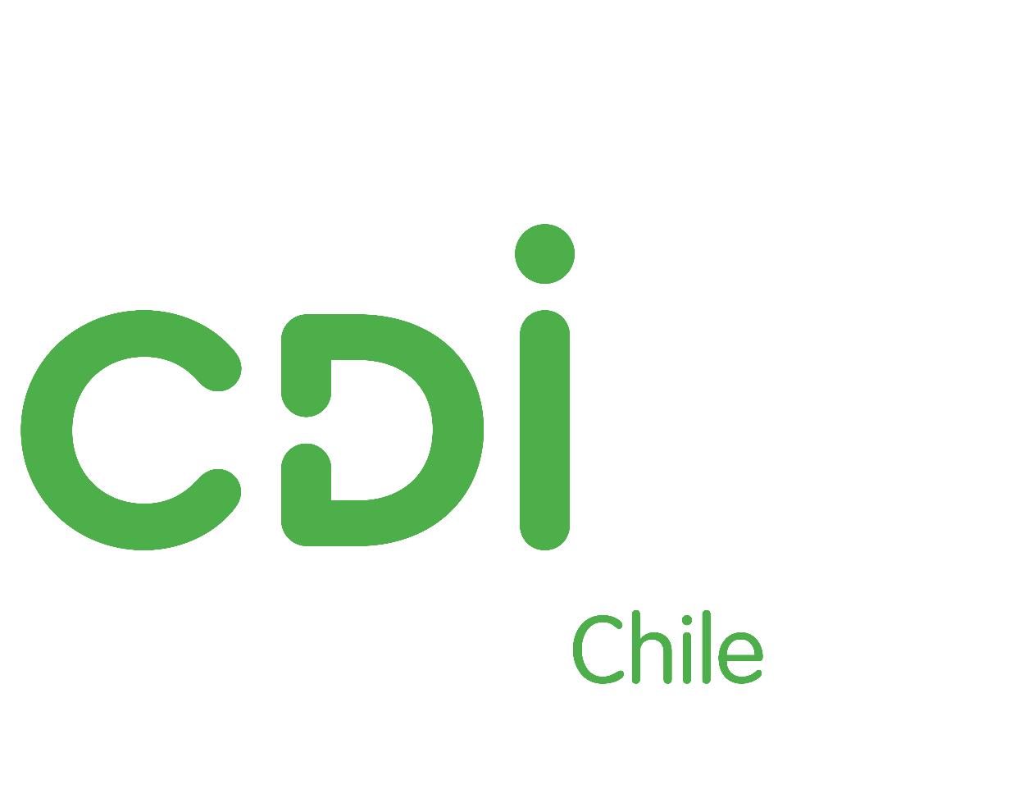
THE "INSIGHTS INTO DEVELOPMENT" CONFERENCE Almaty, June 2018

Slide 2
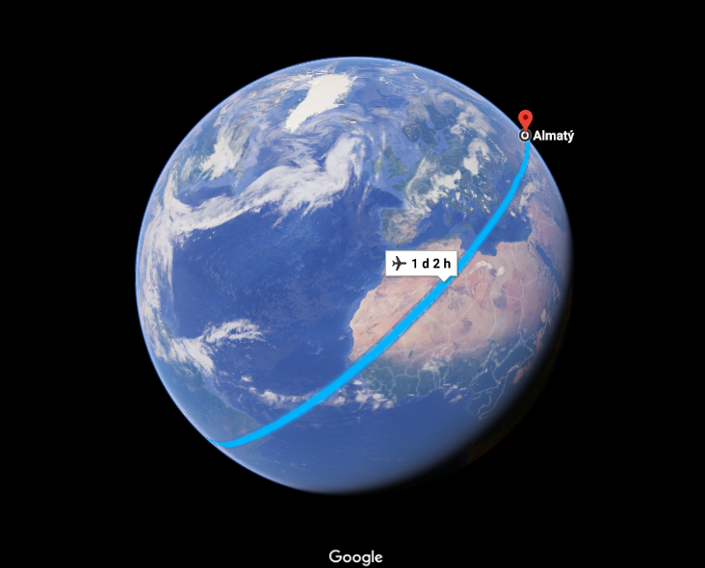
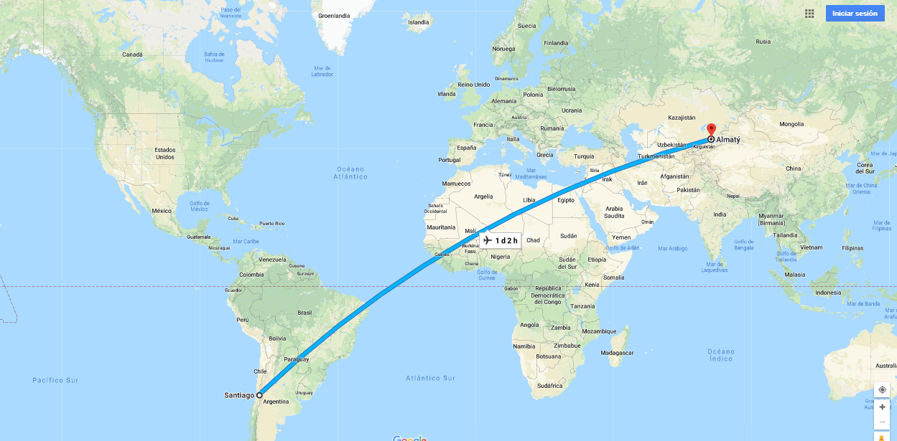
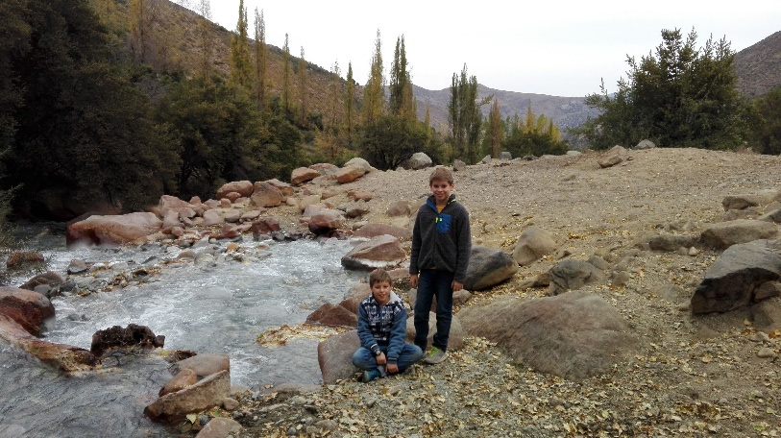
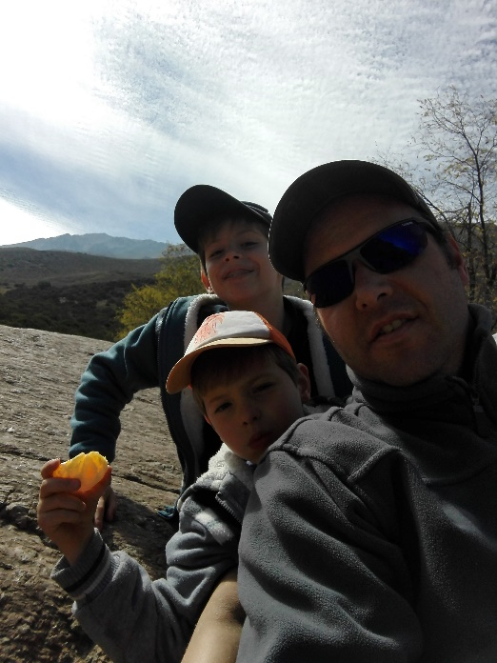
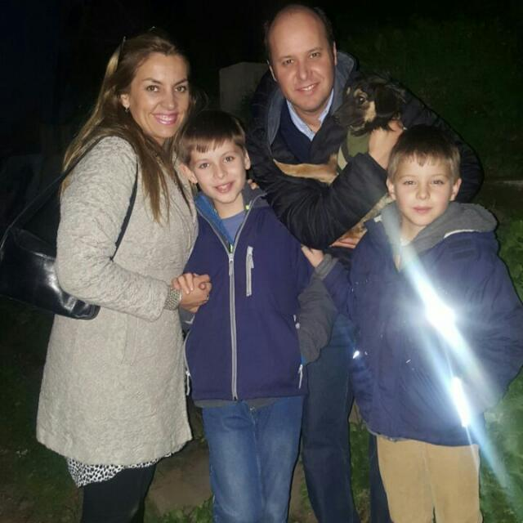
About me: @vergaraeugenio

Slide 3
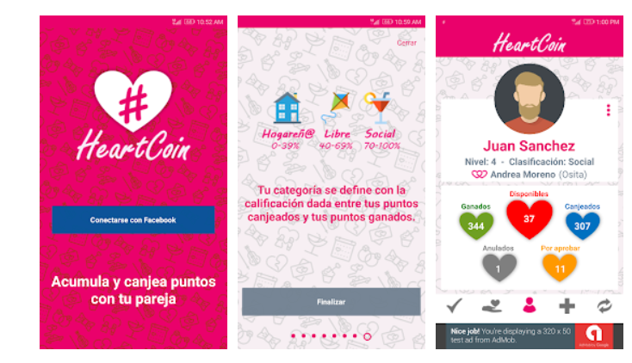
About: @vergaraeugenio
Accumulate and exchange points with your partner

Slide 4
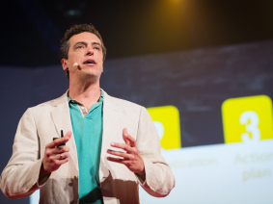
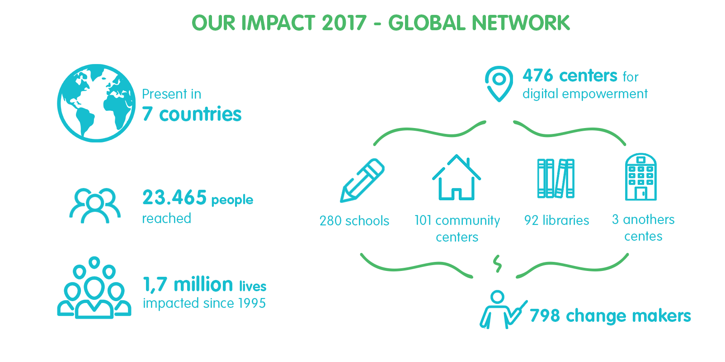
CDI - Global Network Founded in 1995 Empowering communities and people through ICT
Mexico
Portugal
Venezuela
Colombia
Brazil
Rodrigo Baggio, Fundador – Brasil 1995
Chile

Slide 5
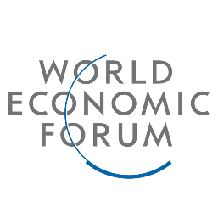
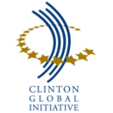
Awards and recognition
Throughout our career, we have won more than sixty awards and international recognition, resulting from the collaborative efforts of our team and our constant inspiration in the outcome of social impacts in the world.

Slide 6
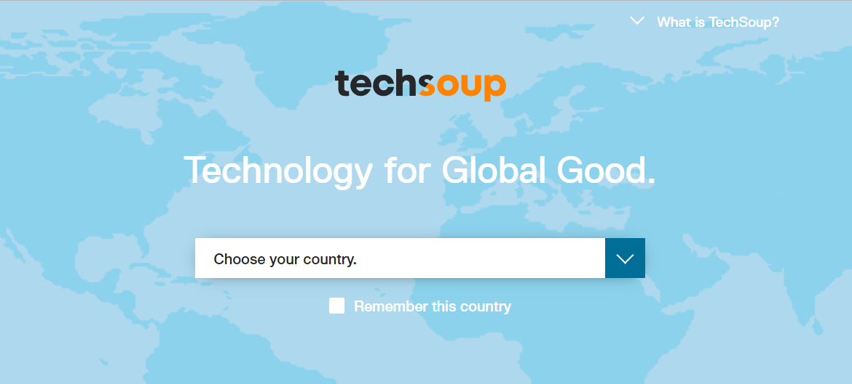
Find TechSoup Offerings for YOUR country

Slide 7
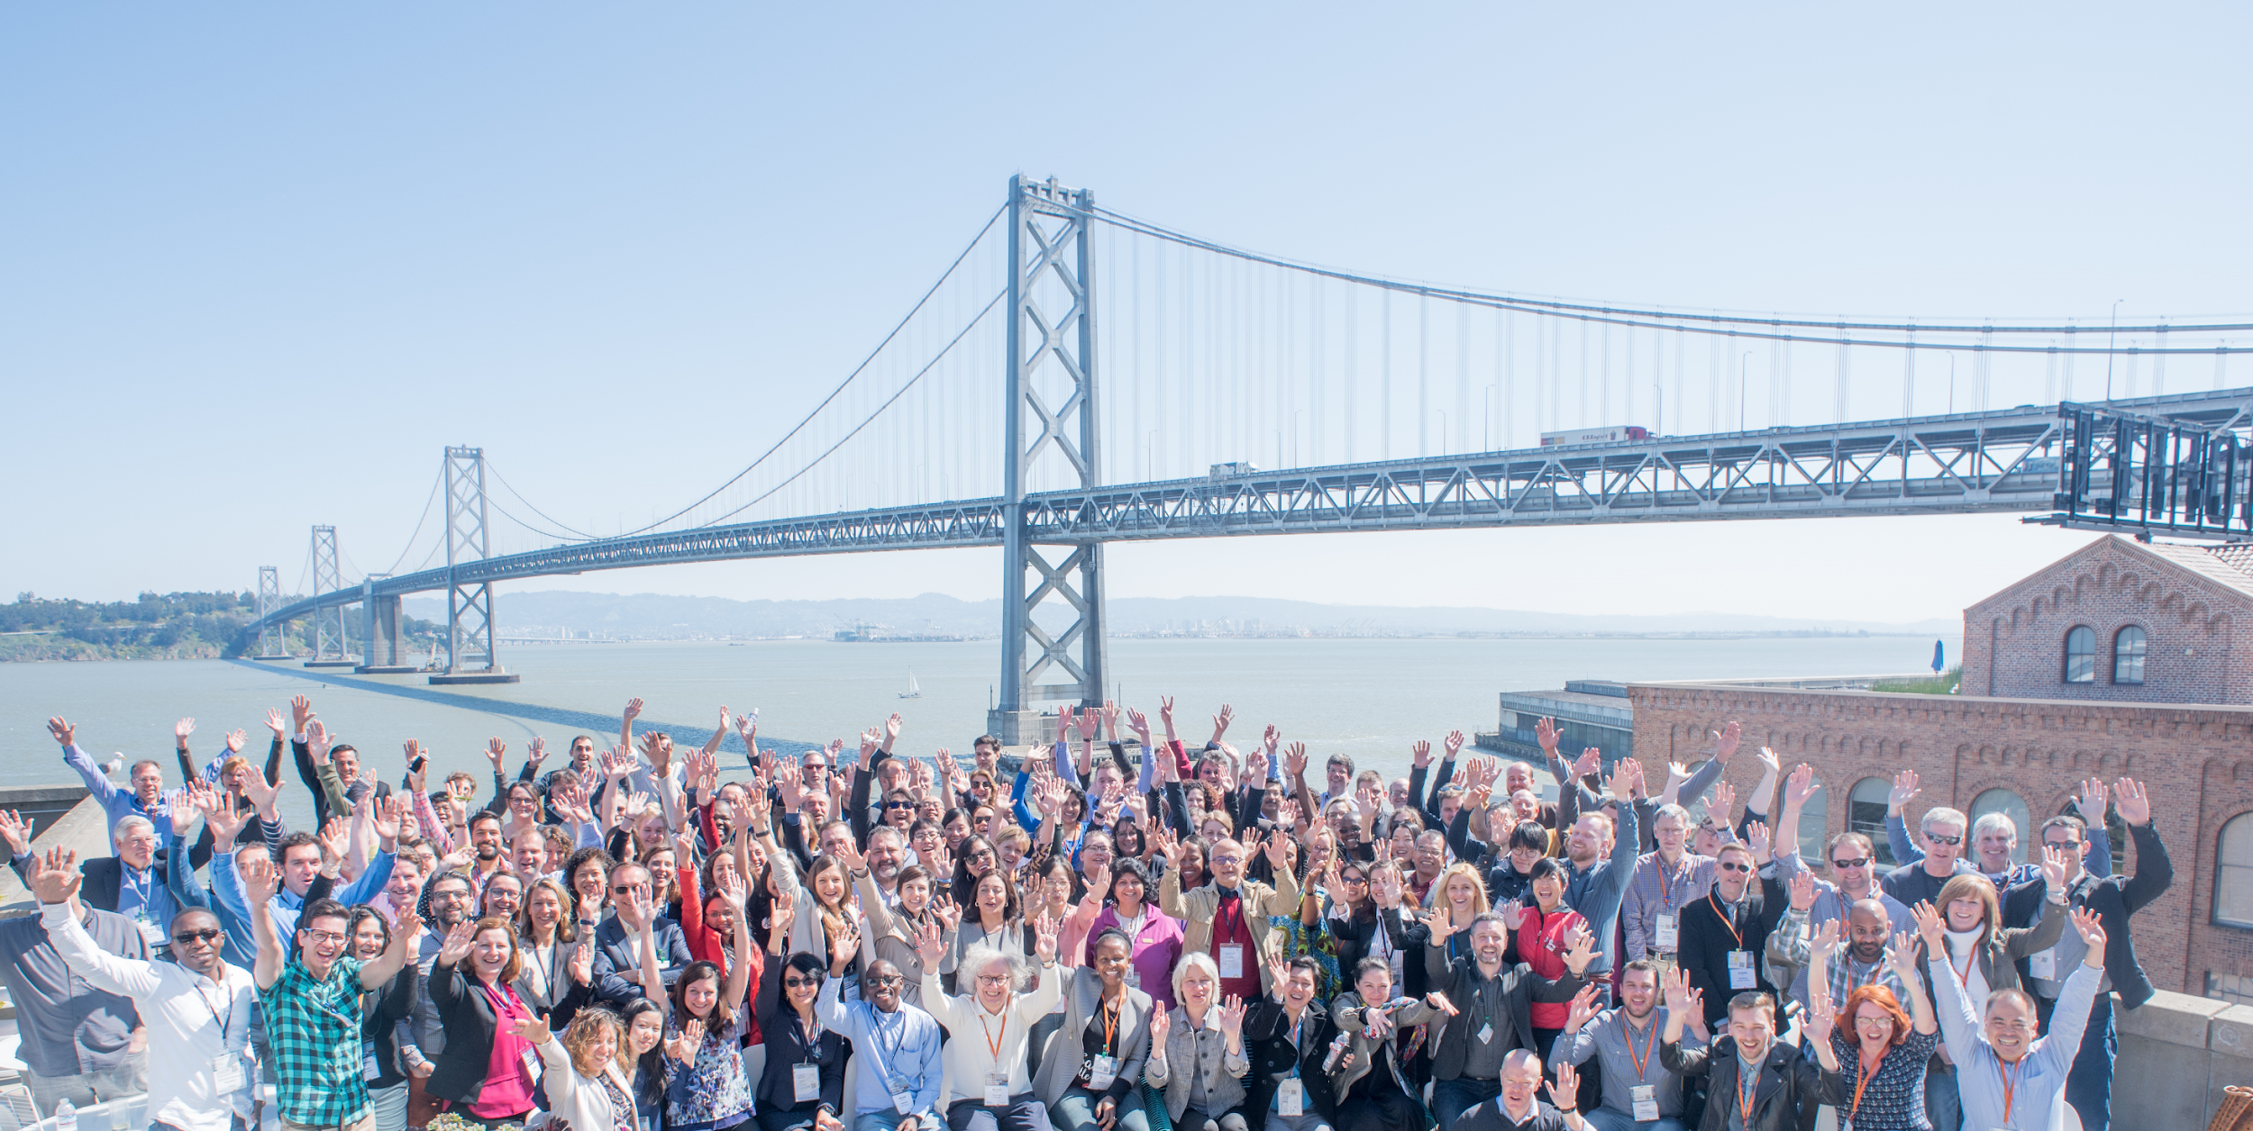
Our Mission:
To build a dynamic bridge that leverages technology to enable connections and innovative solutions for a more equitable planet.

Slide 8
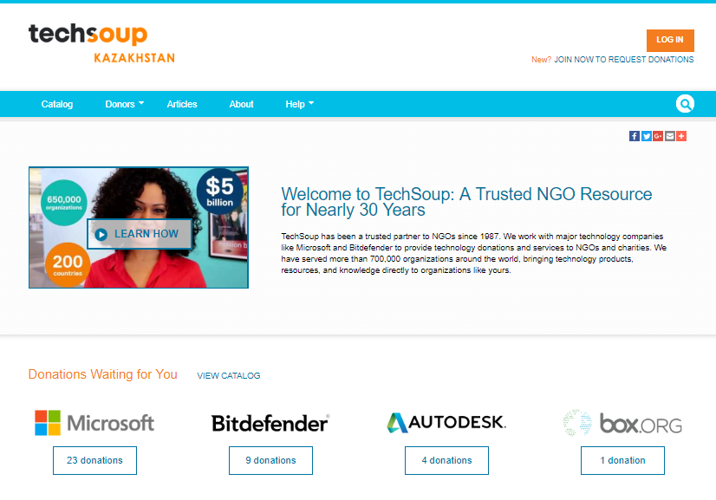
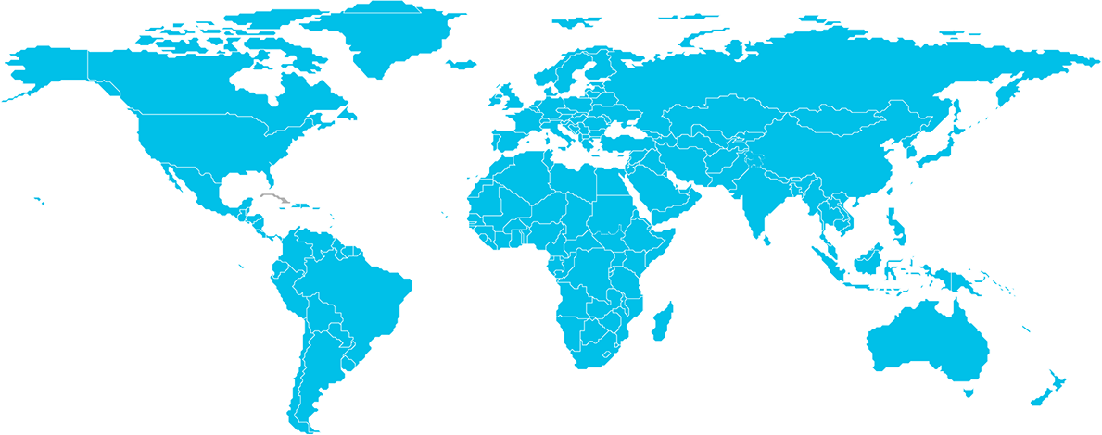
TechSoup programs benefit 1M+ organizations across the globe
Our network of 69 PNGOs + NetSquared local events in 41 countries = US$10.1 in impact worldwide
Europe
415K organizations
North America
405K organizations
Asia Pacific
70K organizations
Middle East and Africa
45K organizations
Latin America
22K organizations
Notes:
8

Slide 9
Europe
415K organizations
Middle East and Africa
45K organizations
Latin America
22K organizations
Notes:
9

Slide 10
IT'S NOT ABOUT CHARITY, IT'S ABOUT JUSTICE' Bono, U2

Slide 11
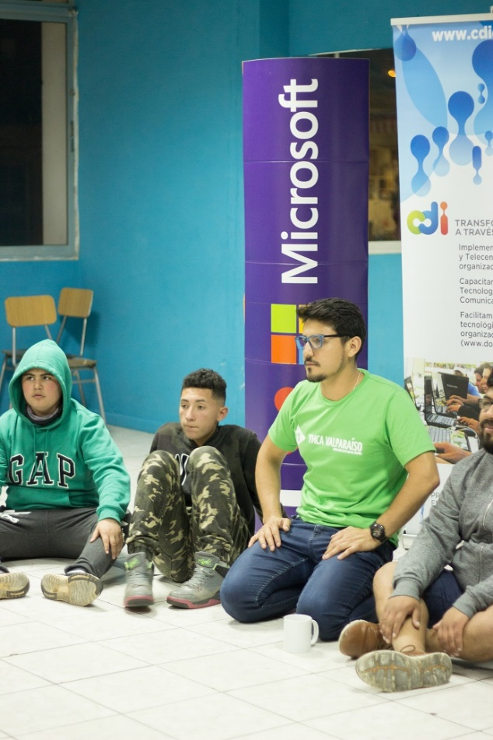
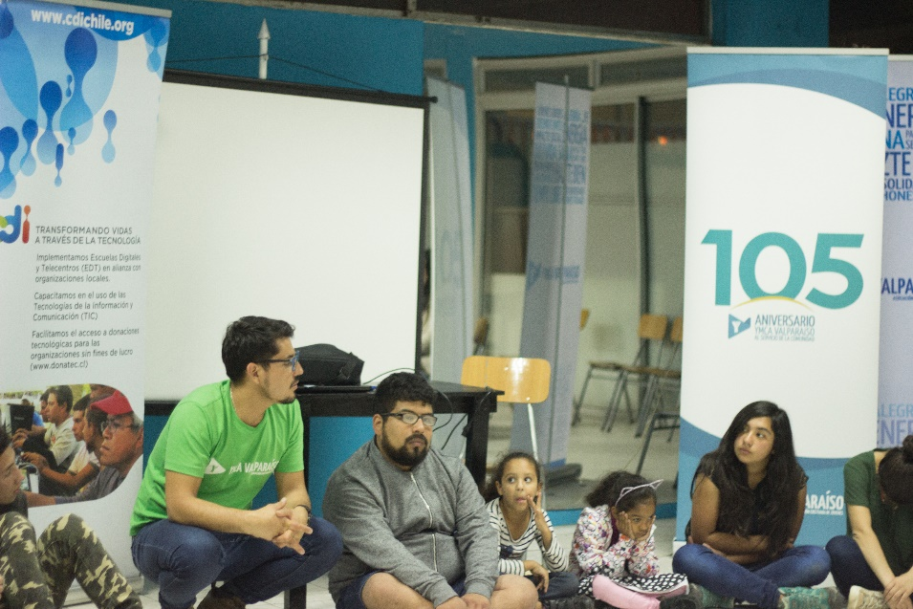
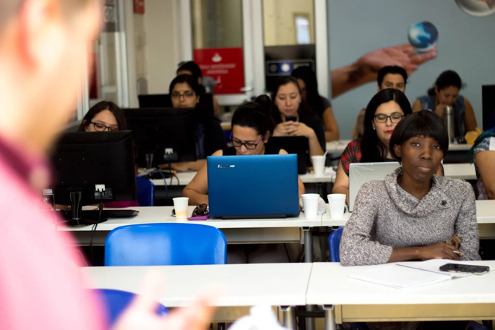
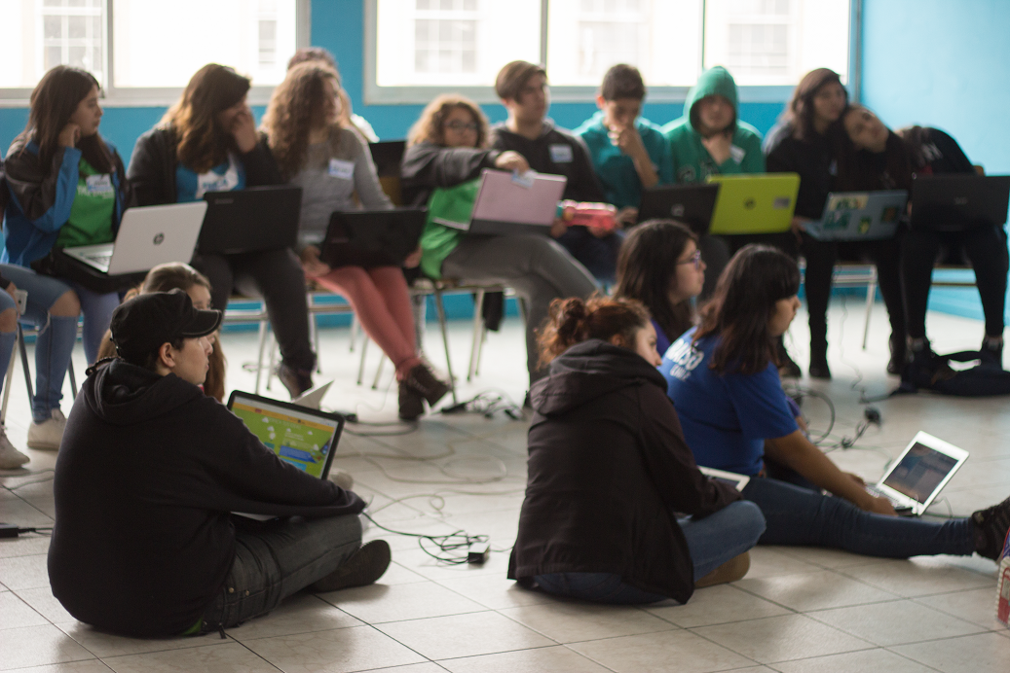
IT'S NOT ABOUT CHARITY, IT'S ABOUT JUSTICE' Bono, U2

Slide 12
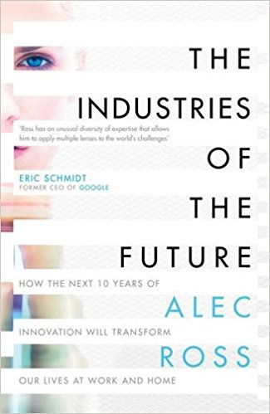
The future relies in the new digital skills
Robotics (AI)
Genomics
IOT
CyberSecurity
Block Chain
Big Data

Slide 13
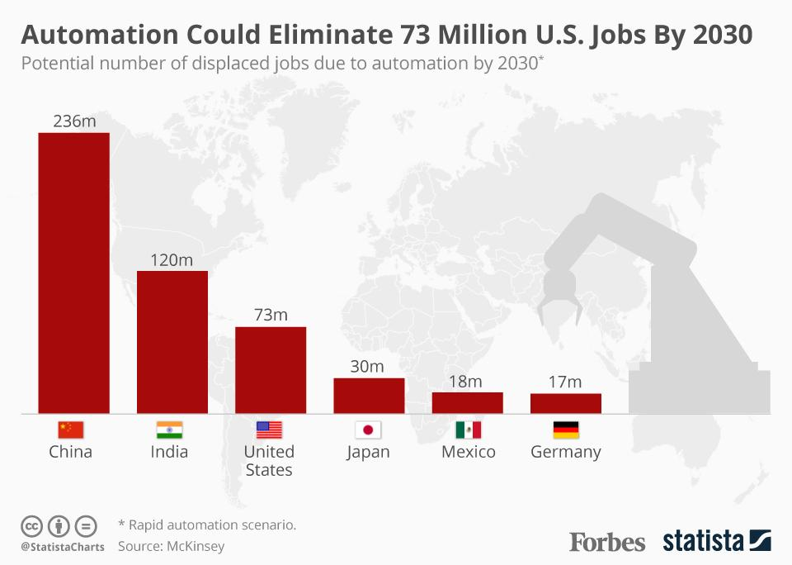
The future relies in the new digital skills

Slide 14
The Code-Ification of Money, Markets and TRUST! (Block Chain)
“.. Alipay payment system performs 2.8 million transaction per minute, ,making it larger tan PayPal or Square.
Coded Markets will now reach into the world´s most isolated communities, and they will link emerging markets to the global economy even closer”
“I think of the SHARING ECONMY as a way of making a market out of anything and a micro entrepreneur out of anybody”

Slide 15
Innovation Labs: Stregthening Civil Society Organizations
2017
Argentina & Ecuador: Entrepreneurs with Impact and NGO Community
Guatemala – Accountability and Transparency
2018:
Chile
República Dominicana and Jamaica

Slide 16
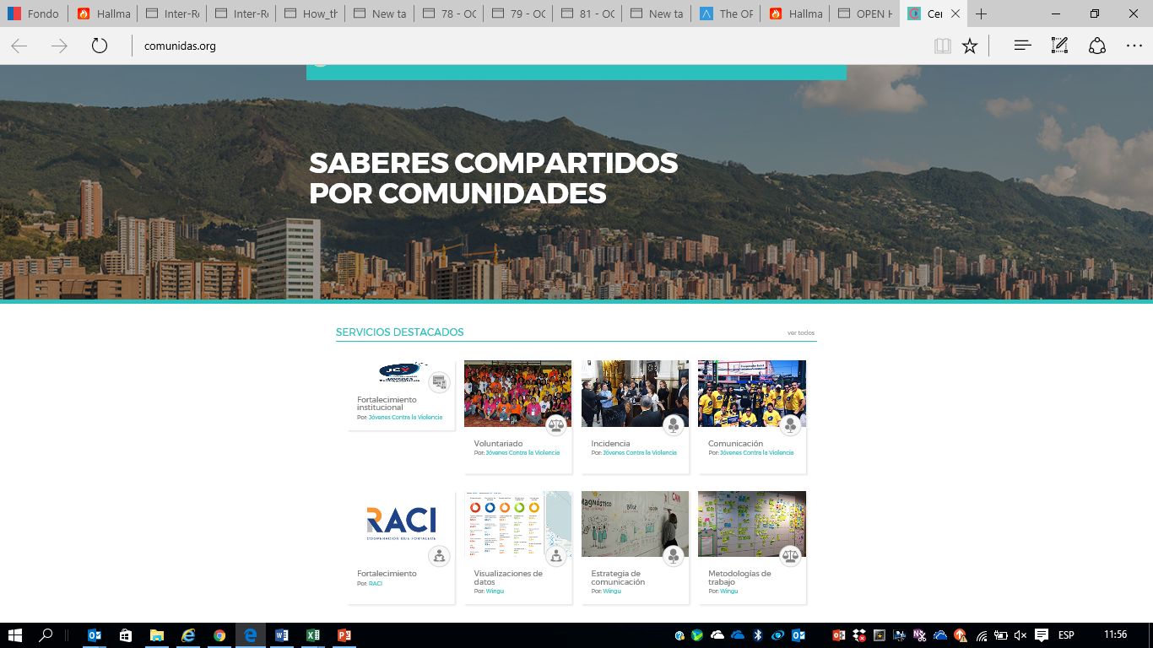
Innovation 4 Change LAC HUB: comunidas.org Sharing platform for and by communities and Ngos

Slide 17
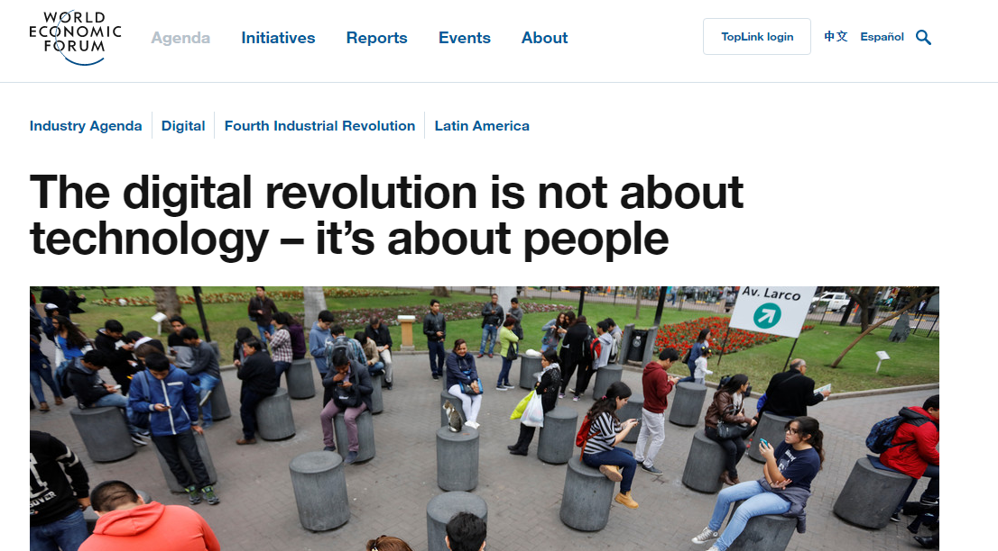
Again, any company can digitally transform, in their own way. However, they should remember one thing: if they make every other change but employees are not empowered, the digital transformation will not be successful. Empowering people is the key to achieving profound and lasting digital transformation that provides sustainable growth and inclusion.

Slide 18
Көп рақмет
Many Thanks!
Mil Gracias!
@vergaraeugenio
eugenio@cdichile.org

