Slide 1
Investing in Technology for Social Good
Noel Dickover

Slide 2
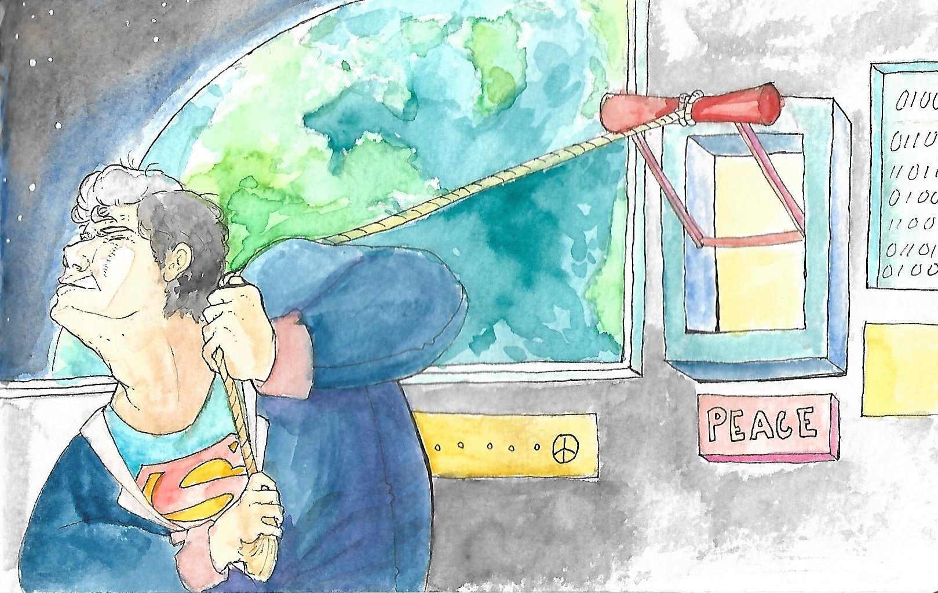
Whose Decision Making Do
You Want to Invest In?

Slide 3
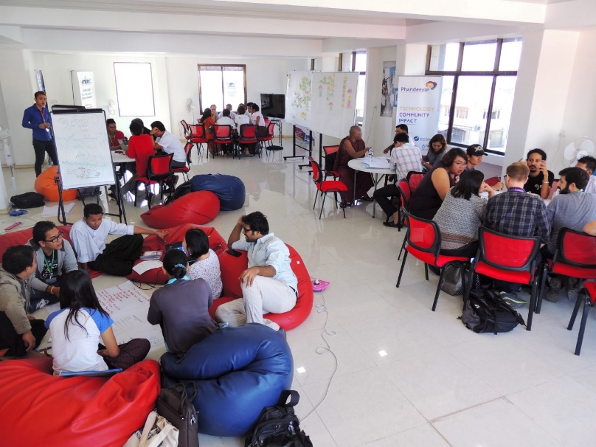
What is the Social Good Environment?
Social Good Actors and purposeful networks
Civil society, entrepreneurial, youth groups, positive govt actors, women, technologists
Structures for information exchange
Co-working and informal meeting spaces
Vibrant news distribution (news media, citizen journalists, NGOs)
Ad hoc sharing systems (WhatsApp and Viber groups, SMS networks)
Events and Information flows
Resources and funding
Notes:
Ecosystems Structures comment.

Slide 4
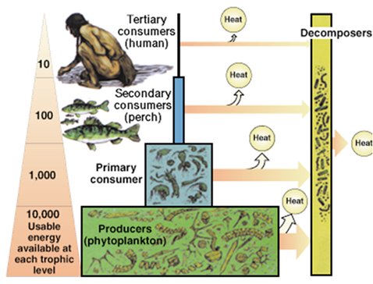
Ecosystems
Organic Growth Around Structures
Runs on Energy
Solar, wind, geothermal, tides
Higher order energy processes emerge
Emergent System Properties
Self defense and resilience
Adaptiveness
New Niches

Slide 5
What is the quality of your social good environment?
How connected are the participants
What level of innovation is happening?
What is the quality and scale of information sharing?
How much trust is there between the participants?
Does everyone know the key challenges, events?
How easy is it to find the social good “clusters”?
Notes:
Develop a repeatable model with the drivers affecting social good, that applied real-time data from social media and news, structured trends data, and local data collection

Slide 6
Tech for Social Good: Improving Local Innovation
Understand local technology and telecommunications use
One-to-many connection between technologists and civil society sectors
Some cities have disconnected tech “pockets”
Tech for social good events should
Overtly connect different communities
Make the technologists as the stars
Bake-in youth participation
Long term engagement and interaction

