Slide 1
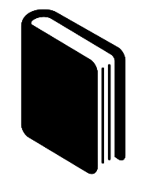
IMPROVEMENT OF STATE AND PUBLIC CONSTRUCTION SYSTEM
Item 2
Development of the Electoral Code of the Republic of Uzbekistan
July 1, 2018
the unification of legislative acts on elections, based on international norms and standards, as well as transparent and effective approaches to electoral processes.
Ensuring healthy competition on the political stage of the country.
Item 7
the abolition of quotas for the Ecological Movement of Uzbekistan in the Legislative Chamber of the Oliy Majlis.
August 1, 2018

Slide 2
Reducing the influence of the government in managing the economy
Item 9
June1, 2018
the transfer of some government functions in licensing procedures to the private sector through the improvement of government control mechanisms and restriction of the creation of business structures with the participation of the government
Development of the draft law of the Republic of Uzbekistan ‘On Public Service’
Item 10
Provides the basic principles of activity, the definition of the legal status, material and social security of civil servants
July 1, 2018
Item 13
Construction of modern buildings of the centers of public services of districts (cities) – People’s Receptions
February 1, 2018
The Program provides for the construction of public service centers - the new buildings of the People’s Receptions during 2018-2020

Slide 3
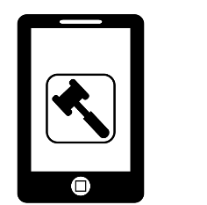
Ensuring high quality, efficiency, openness of public services
Item 14
-provision of public service centers with information booths
-rendering public services with the help of mobile applications
-introduction of the practice of providing mobile (special vehicles) public services for people living in remote regions.
February 1, 2018
Introduction of 40 types of public services to legal entities and 19 types of public services to individuals
Item 16
March 10, 2018
The project approves the roadmap and introduces public services on the principle of Single Window
Broad introduction of information and communication technologies in the sale and lease of state property
Item 22
placement of information on the objects of state property provided in a lease in a single portal
March 20, 2018

Slide 4
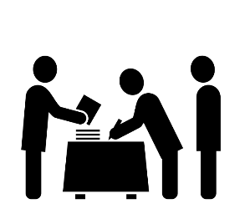
Simplification of procedures for travelling of citizens abroad
Item 27
April 20, 2018
Implementation of the phased introduction of ID-cards in the territory of Uzbekistan.
Creating the Mening Fikrim special web portal
Item 34
creation of a special site in the Internet network that provides an opportunity to make initiatives of public concern
April 20, 2018
Item 38
Preparation of the Census Conception
May 1, 2018
The drafts provide:
-purpose of the population census;
-circle of subjects involved in the population census and their tasks;
-timing and mechanisms of the census.

Slide 5
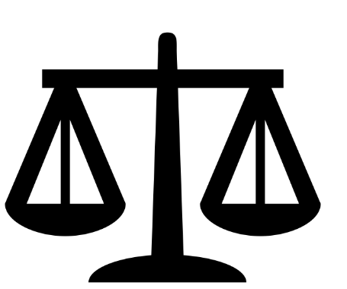
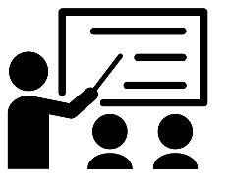
ENSURING THE RULE OF LAW AND REFORMING THE JUDICIAL AND LEGAL SYSTEM
Improving the quality and effectiveness of training judges
Item 48
June 30, 2018
It is planned to establish the Academy of Justice of Uzbekistan
Expansion of judicial control over the inquiry and preliminary investigation
Item 50
The draft provides for the transfer of the sanction (consent) to the conduct of a search and wiretapping to negotiations conducted from telephones and other devices from the Prosecutor’s Offices to the courts
July 20, 2018

Slide 6
Strengthening of logistical capacity of penal institutions
Item 53
Throughout the year
repair and reconstruction of buildings and structures of penal institutions and provision of video surveillance cameras and other means
Reducing in the number of patrol and inspection posts between the regions of the republic and introducing modern ICT into the system.
Item 55
Reducing the number by at least half, abolish inter-district posts (except for border areas)
April 10, 2018
Simplification of the procedure for permanent and temporary registration
Item 56
March 20, 2018
-simplification of existing requirements for the purchase of real estate for citizens with a permanent residence permit in the city of Tashkent and Tashkent region;
-cancellation of the requirements for concluding lease contracts for persons involved in seasonal work

Slide 7
Development of the draft law of the Republic of Uzbekistan ‘On law enforcement agencies
Item 62
The draft provides:
-legal status of law enforcement agencies;
-powers and duties of each law enforcement agency on the basis of their specific activities
October 10, 2018
Development of the draft law ‘On the National Security Service of the Republic of Uzbekistan’
Item 63
June 10, 2018
The draft provides tasks and functions, the legal status and powers of the National Security Service in ensuring the protection of the state against external and internal threats
Implementation of effective comprehensive measures to eliminate corruption, the causes and conditions that contribute to it.
Item 64
Further improvement of anti-corruption legislation and creating an unacceptable attitude towards corruption in society
November 1, 2018

Slide 8
Introduction of mechanisms of openness and transparency of the activity of law enforcement bodies
Item 70
September 20, 2018
Introduction of video cameras, which allow fixing the performance of service by road patrol and and inspection officers
Establishment of the Academy of General Prosecutor’s Office
Item 77
construction of a single complex of the prosecution authorities and wide introduction of innovative methods and types of teaching, advanced pedagogical and ICTs
May 1, 2018
Improvement of the system of training highly qualified legal personnel.
Item 79
April 20, 2018
Increase in the admission and
expansion of the educational and methodological base of the Tashkent State Law University.

Slide 9
ИҚТИСОДИЁТНИ РИВОЖЛАНТИРИШ ВА ФАОЛ ТАДБИРКОРЛИКНИ
ҚЎЛЛАБ-ҚУВВАТЛАШ
Development of a new version of the draft law ‘On Currency Regulation’
Item 86
September 30, 2018
Simplification of procedures for the regulation of foreign exchange transactions on the basis of a comprehensive study of international experience and the needs of entrepreneurs
By wide application of innovative technologies to develop modern retail payment systems integrated with the leading international payment systems.
Item 88
The draft provides for the development of organizational and legal bases and mechanisms for the operation of modern retail payment systems integrated with the world’s leading payment systems (Visa, Mastercard, Union Pay, PayPal and others).
September 1, 2018

Slide 10
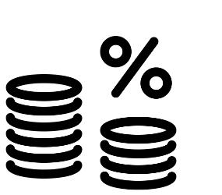
Ensuring openness and transparency of information on revenues and expenditures of the state budget for the population
Item 91
Throughout the year
The project envisages specific mechanisms aimed at ensuring openness and transparency of revenues and expenditures of the state budget and extra-budgetary trust funds for the population and take public opinion into account when discussing them
Accelerate the process of coordinating national standards with international standards
Item 92
With the purpose of export and tourism development, to adopt in the republic the best agricultural practices (Global G.A.P.), ‘halol’ and ‘kosher’ standards
April 10, 2018
Expansion of production and tax base by reducing and simplifying the tax burden.
Item 94
December 1, 2018
-granting the right to defer payment of a single tax payment for a certain period when building objects for own needs for newly created business entities;
-introduction of incentive schemes for small businesses with a view to their transition to the payment of value added tax.

Slide 11
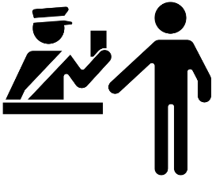
The radical improvement of the customs legislation, bringing this system in line with the requirements of advanced international standards.
Item 97
Concept of Improving the Customs Legislation will be approved with the draft, which provide:
-determination of areas for improving the Customs Code;
-development of mechanisms ensuring a high transparency in customs administration
October 10, 2018
Termination of the monopoly in the production of electricity and the promotion of the use of alternative energy sources.
Item 99
June 30, 2018
The draft provides for the improvement of the legal basis for the production and delivery to consumers of electricity received from alternative sources, as well as the provision of incentives encouraging the development of this field.
Systemic development of domestic tourism, creating the necessary infrastructure, and broadly promoting the tourism potential of the regions.
Item 100
Approval of an action plan for the implementation of the ‘Travel around Uzbekistan’ Domestic Tourism Development Program and granting of additional preferences to business entities conducting their activity in domestic tourism
February 20, 2018

Slide 12
Take measures to develop a system of health tourism
Item 103
September 20, 2018
Adaptation of medical and health facilities to receive foreign citizens, first of all citizens of Central Asian countries
Restoration of the national aviation industry and formation of aerospace industry as a new branch of the economy
Item 115
Definition of a government agency responsible for regulating aerospace activities and development of the strategy of the Republic of Uzbekistan for the formation and development of the aerospace industry for 2018-2035;
June 10, 2018
Reduction and simplification of permits and licensing procedures in business
Item 130
March 20, 2018
Abolition of certain permission and licensing procedures for business, optimization of some of them, cutting the terms of registration, decentralization of certain functions in the licensing and permission procedure

Slide 13
DEVELOPMENT OF SOCIAL AREA
Legal regulation of the concept of ‘consumer basket’
Item 139
July 1, 2018
-definition of a concept of ‘consumer basket’, as well as the criteria for its definition;
-ensuring a phased conformity of real incomes of the population, wages, pensions and other payments with the ‘consumer basket’ in the context of the territories.
Development of the draft law of the Republic of Uzbekistan ‘On the rights of persons with disabilities’
Item 143
The draft law will stipulate:
-the rights of persons with disabilities;
-the powers of state bodies to protect the rights of persons with disabilities;
August 1, 2018

Slide 14
Introduction of a unified information system for monitoring prices of medicines
Item 146
June 30, 2018
Provision of information on certain types of medicines in the Internet, the state of wholesale and retail prices and the dynamics of price changes
Adapting the concepts of ‘Smart Medicine’ and ‘Center for Unified Medical Information’
Item 147
Comprehensive measures to introduce new, advanced and proven methods of prevention and early diagnosis of common diseases
December 30, 2018
Introduction of an effective system to reveal medical malpractice
Item 152
March 30, 2018
-creation of an expert group to ensure the protection of patients from medical malpractice in each medical institution;
-establishment of a procedure of notifying health authorities of cases of medical malpractice and conduct of internal investigation;
-release of a doctor from liability in case if the medical malpractice is admitted and the damage is reimbursed

Slide 15
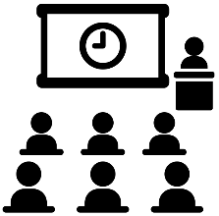
Development of the concept of phased introduction of health insurance
Item 153
-phased introduction of health insurance;
-ensuring equal rights of citizens to medical and preventive services, guaranteed quality of medical services on the basis of insurance policies;
2018 йил 1 апрель
Ensuring maximum transparency of entrance examinations to higher education institutions, strengthening of public control, and ensuring the implementation of modern mechanisms of prompt processing of test results
Item 163
April 20, 2018
-conduct of entrance tests to universities for several days;
-announcement of the results of the tests on the next day after the tests;
Increase of admission quota to higher education institutions for 2018-2019 academic year by at least 20 percent against 2017/2018.
Item 164
The document stipulates:
-further expansion of citizens' access to higher education;
-enrollment in higher education institutions on individual preferential quotas for active members of the Youth Union of Uzbekistan
May 10, 2018

Slide 16
Ensuring security, religious tolerance and interethnic accord, pursuance of a balanced, mutually advantageous and constructive foreign policy
Further strengthening of the defense power of the state and military power of the Armed Forces of the Republic of Uzbekistan
Item 202
April1, 2018
Draft Decree of the President of the Republic of Uzbekistan
Further improvement of the system of social rehabilitation of the citizens affected by extremist ideas, and their recovery for a healthy life
Item 207
Intensification of actions to prevent the dissemination of adverse religious ideas among the population, remission and recovery of citizen for a healthy life, mainly youth, related to terrorism and extremism.
June 30, 2018

Slide 17
Conduct of the Republican Quran Reciting Competition.
Item 213
June 30, 2018
- organization of district, regional and national stages of the competition;
Actions to ensure worthy awards for winners and laureates of the competition.
Development of the draft UN Convention on the Rights of Youth in collaboration with the UN and foreign partners
Item 217
-build and implement a youth policy in the current conditions of rapid growth of globalization and ICT development;
-ensure rights and freedoms of young people, and guarantees for their implementation;
November 10, 2018
Conduct of the Asian Forum on Human Rights on the occasion of the 70th anniversary of adoption of the Universal Declaration of Human Rights.
Item 221
September 20, 2018
Organizational arrangements for holding the Forum in 2018 in Samarkand

Slide 18
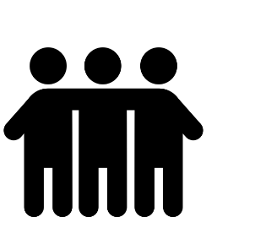
Opening of new diplomatic missions abroad, as well as expansion of the existing ones
Item 227
Throughout the year
It is planned to open consulate offices in Yekaterinburg, Vladivostok, Kazan, Rostov-on-Don (RF) and Almaty (Kazakhstan)
Development of the concept of state policy on cooperation with foreign compatriots
Item 228
Simplification of the procedure of obtaining entry visas, permanent residence permits in Uzbekistan, work licenses for compatriots living abroad
July 20, 2018
Fundamental improvement of performance of the Ministry of Foreign Affairs and dimplomatic missions of Uzbekistan abroad
Item 229
March 15, 2018
Review the activities of the Ministry of Foreign Affairs and diplomatic missions abroad in terms of maintaining foreign economic activity and increasing the role of tourism in the development

Slide 19
Measures to streamline external labor migration and fundamentally improve the procedure
Item 231
It is planned to:
-expand the labor migration map jointly with developed countries;
-sign relevant medium- and long-term agreements with foreign countries;
-cancel the procedure of issuing permits for working abroad for citizens of Uzbekistan;
-fundamentally review the operation of the Agency on External Labor Migration;
May 1, 2018
Total expenditure meant for the implementation of measures within the 2018 State Program:
11 239,2 billion UZS and 1 284,9 million USD

