Slide 1
CSOs Needs Assessment of Online/Distant Learning for Web Academy
in Central Asia and Azerbaijan
May 2017

Slide 2
Goal and Objectives
Goal: Study and analyze the current situation in the area of distant/online learning of CSOs in Central Asian countries and Azerbaijan, prepare recommendations for the development and introduction of modern training courses.
Objectives:
Identify best practices of organizing distance/online training courses in local higher educational institutions
Identify gaps, challenges and risks in operation of distance/online training courses
Determine topics for training courses that are in the highest demand, and make needs assessment in terms of the courses content
Study the conditions and elaborate recommendations on how to organize and introduce distance/online training courses subject to country specifics
Study the main conditions and elaborate recommendations on providing distance/online training of CSOs on a paid and scholarship basis subject to country specifics.

Slide 3
Methodology
Analysis of secondary data (desk study)
legislation;
reports of government agencies (ministries, regional administrations, etc.)
data of state statistics;
data of sectoral scientific research institutes;
scientific libraries;
publications: reports of higher educational institutions, mass media, Internet, industry magazines;
data received from experts during informal contacts and other documents.
Qualitative research using a method of focus groups and in-depth interviews with experts and professionals in the area of education, distance/online learning and information technologies.

Slide 4




Target groups
320 participants total
Group 1 – 28
Experts, representatives of local higher educational institutions dealing with organizing distance/online learning
Group 2 – 126
CSO representatives and local community leaders; CSOs that provide training for CSOs;
interested CSO representatives who were trained online/remotely
Azerbaijan - 5,
Kazakhstan - 9,
Kyrgyzstan - 8,
Tajikistan- 4,
Turkmenistan - 2
Azerbaijan - 16,
Kazakhstan - 47,
Kyrgyzstan - 28,
Tajikistan- 27
Turkmenistan - 8
Azerbaijan - 20,
Kazakhstan - 55
Kyrgyzstan - 35
Tajikistan- 56
Turkmenistan - 7
Azerbaijan - 5,
Kazakhstan - 6,
Kyrgyzstan - 5,
Tajikistan- 6,
Turkmenistan - 1
Group 3 – 143
Students studying social areas of specialization who want to continue studying and build a career in this area
Group 4 – 23
Representatives of stakeholders working with NGOs (business companies, donor organizations and state structures)

Slide 5
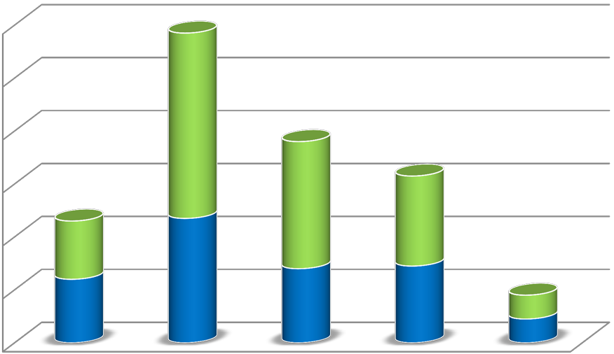
Gender representaton
120
100
80
70
F
60
48
M
34
40
22
47
20
24
28
29
9
9
0
Turkmenistan
Azerbaijan
Kazakhstan
Kyrgyzstan
Tajikistan

Slide 6
Current situation and best practices of organizing distance/online training courses in local HEI
Azerbaijan | Kazakhstan | Kyrgyzstan | Tajikistan | Turkmenistan
Some lecturers conduct particular part of the courses by use of Skype Some lecturers partially implement some course exercises in distance/ online education form through Office365 | DL since late 90-s Most HEI have well developed infrastructure for DL A lot of universities run either DL or blended learning courses Al Farabi KNU develops MOOC platform MOOCs are intentionally popularized (National best teacher contest) Rules and Regulations by MES RK | Some degree of experience with MOOCs (e.g. Coursera) Webinars for NGO Online courses as support for F2F courses | DL is practiced by 2 HEIs Universities open DL Centres There is interest among HEI to develop DL HEI hire IT professionals to develop DL | Favourable legal framework for DL development Respondents have had personal experience of DL No local DL programmes

Slide 7
Gaps, challenges and risks in operation of distance/online training courses
Azerbaijan | Kazakhstan | Kyrgyzstan | Tajikistan | Turkmenistan
No relationship between demand and supply of training programs Azerbaijani universities carry no experience in online education International online educational diplomas are not nostrified (approved) by the ME of the Republic of Azerbaijan No legal and formal backing of online/ distance education | Poor Internet connection in some regions ECTS Credits are not transferred Problem of student authentication at DL Lack of “live” communication with the instructor DL is stereotyped as less prestigious form of education Trainers from Kazakhstan are not well-known and need promotion | Low motivation of young people to work for NGO can influence the demand for WA courses | No or poor internet connection in some regions Lack of facilities and equipment Mentality and bias against DL Lack of DL and IT professionals | No trained DL professionals No NGO trainers Slow and costly Internet connection Some social media, used in DL, are banned

Slide 8
Opportunities for development distance/online training courses in the target countries
Azerbaijan | Kazakhstan | Kyrgyzstan | Tajikistan | Turkmenistan
There are trained professional lecturers in CSO management field Excellent technical basis Within the "State Program on socio- economic development of regions of the Republic of Azerbaijan for 2014-2018 ", it is intended to launch regional universal center to conduct DL services in regions of Azerbaijan. | NGOs are aware that they need to update their staff professional skills HEIs are ready to collaborate with NGOs in the field of DL There are trained professionals and a well-built infrastructure | Non-formal education is not strictly regulated by the government Positive attitude towards online courses among population Respondents think that on-line courses blur boundaries between countries | HEIs are very motivated to develop DL | NGO that work with disabled people support the idea of DL

Slide 9
Topics of training courses that are in the highest demand, recommendations on the courses content
Azerbaijan | Kazakhstan | Kyrgyzstan | Tajikistan | Turkmenistan
Legislation for CSO (registration of organizations and projects; CSO taxation and reporting, etc.) HR management Professional growth Advocacy Financial (budget), project management Result oriented coordination and fundraising | Fundraising , crowd funding Project management Writing a project proposal Legislation for NGO Strategic planning Accounting and taxation Time management Marketing, PR, SSM Monitoring and assessment Social partnership Advocacy | NGO management NGO organizational structure and development Fundraising Social work Monitoring and assessment | Labour migrants Fundraising Gender equality Psychology Social entrepreneurship Presentation and visualization skills Vulnerable society groups Team building Capacity building Writing a project proposal Legislation and taxation Volunteering Collaboration with Government HR management Project sustainability Strategic planning | Social partnership Financial issues NGO legal sustainability Social adaptation and rehabilitation of disabled people Different topics of NGO specialization

Slide 10
Recommendations on how to organize and introduce distance/online training courses for the P4I Program - 1
Azerbaijan | Kazakhstan | Kyrgyzstan | Tajikistan | Turkmenistan
Advocacy campaigns to make DL diplomas recognized Prepare lecturers for DL with technical and presentation (soft) skills DL awareness promotion among students and public Scholarships Adapt best practices Involve international /high quality trainers Continued on next page | Accumulation of experience Create a single online platform for NGOs - Resource Centre of NGO materials Multilevel courses from basic to advanced Study the experience of existing programmes Blended learning Cater for bilingual population Possibility of downloading materials or printing them Continued on next page | Languages of instruction Focus on specific topics, find a “niche” Flexible self-paced programmes General and more specific courses Fee Reliable certificates Access from different devices VLE | Develop legal framework Involve professionals Chose relevant topics Promotion Take into consideration demand for courses Train the trainers No ads Create DL centres for NGOs Promote courses through social media and TV Create registry (database) of NGO topics | Dialogue on the national level Clear message and rationale behind the DL courses Develop legal framework Choice of language of instruction

Slide 11
Recommendations on how to organize and introduce distance/online training courses for the P4I Program - 2
Azerbaijan | Kazakhstan | Kyrgyzstan | Tajikistan | Turkmenistan
Develop relevant study materials Training materials in Azerbaijani language Make a pilot program first Create an institution (or hub) which would support existence and development of CSOs in a sustainable way Special database or e-platform should be created composed of lecturers, modules, exercises and cases, curriculums | Free courses and fee-based courses Relevant workload Focus on practical application Final attestation Certificate or diploma (preferably licensed) Choice of language of instruction Prominent speakers/trainers

Slide 12
Some conclusions and ideas for Web Academy
There are major differences in the DL expertize and infrastructure in the target countries.
Preferred language of instruction depends on the region.
NGOs see the necessity of professionalizing their staff through online courses
Common challenge: poor/no internet connection
Common challenge: no/unfriendly legislation, unclear status of DL courses.
Develop different approaches to DL promotion and deliverance in the target countries
Develop courses in national languages along with Russian or English.
NGOs will constitute the main audience of the WA courses
Think of possibility to distribute material as digital packages available for downloading
Work with stakeholders and raise awareness about DL opportunities

Slide 13
Some conclusions and ideas for Web Academy
Topics the NGOs interested in can be divided into 3 clusters:
NGO management
Financial issues
NGO profile-specific topics
Demand for WA courses will depend on quality and relevance of the material, the professional level of educators and the status of the certificate
The courses should be accessible from different devices
Fee-based courses can be offered along with free courses
The idea of creating a resource centre / hub / database of materials can be considered

Slide 14
Contacts
Web Academy
Civil Society Development Association ARGO 36, Zhandosov Str., Almaty
050057 Kazakhstan
Tel. +7 727 250 27 87/88/89
Website: www.cso-central.asia

