Slide 1
Инновации в Гражданском Обществе
Кайша Атаханова, Программа P4I
По материалам Джессики Хайнзельман, CHANGE

Slide 2
ЧТО ТАКОЕ
ИННОВАЦИЯ?
Notes:
How many of you could confidently define innovation? If you’re not totally sure, you’re not alone. People use this word to mean so many different things. Generally it means getting improved results by doing things differently, but even within this broad definition…

Slide 3
Существуют различные виды инноваций…
Notes:
There are many different types of innovation. I’ll share two of the most common with you…

Slide 4
ПРОРЫВНАЯ:
принципиально новое решение, направленное на рассмотрение проблемы, которая не поднималась до этого
Notes:
Probably the most common understanding of innovation is “Disruptive Innovation” – a totally new solution that addresses a problem that hasn’t been addressed before. Disruptive innovation fundamentally changes our lives, allowing us to do things that weren’t previously possible. Some examples through history include…

Slide 5
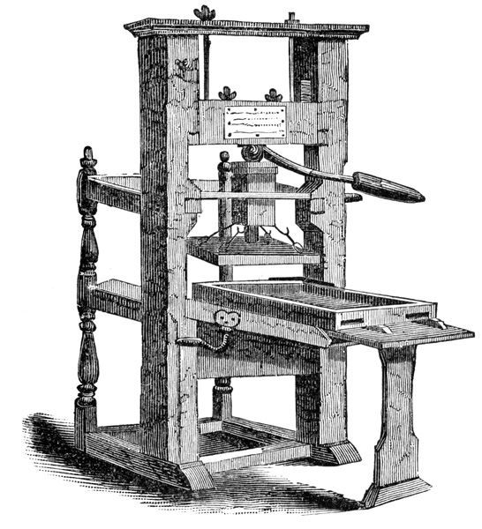
Notes:
The invention of the printing press that allowed people to mass produce printed materials and distribute ideas and knowledge at a scale that was not previously possible. What would today be like if we had to hand write each copy of newspapers, magazines and books?

Slide 6
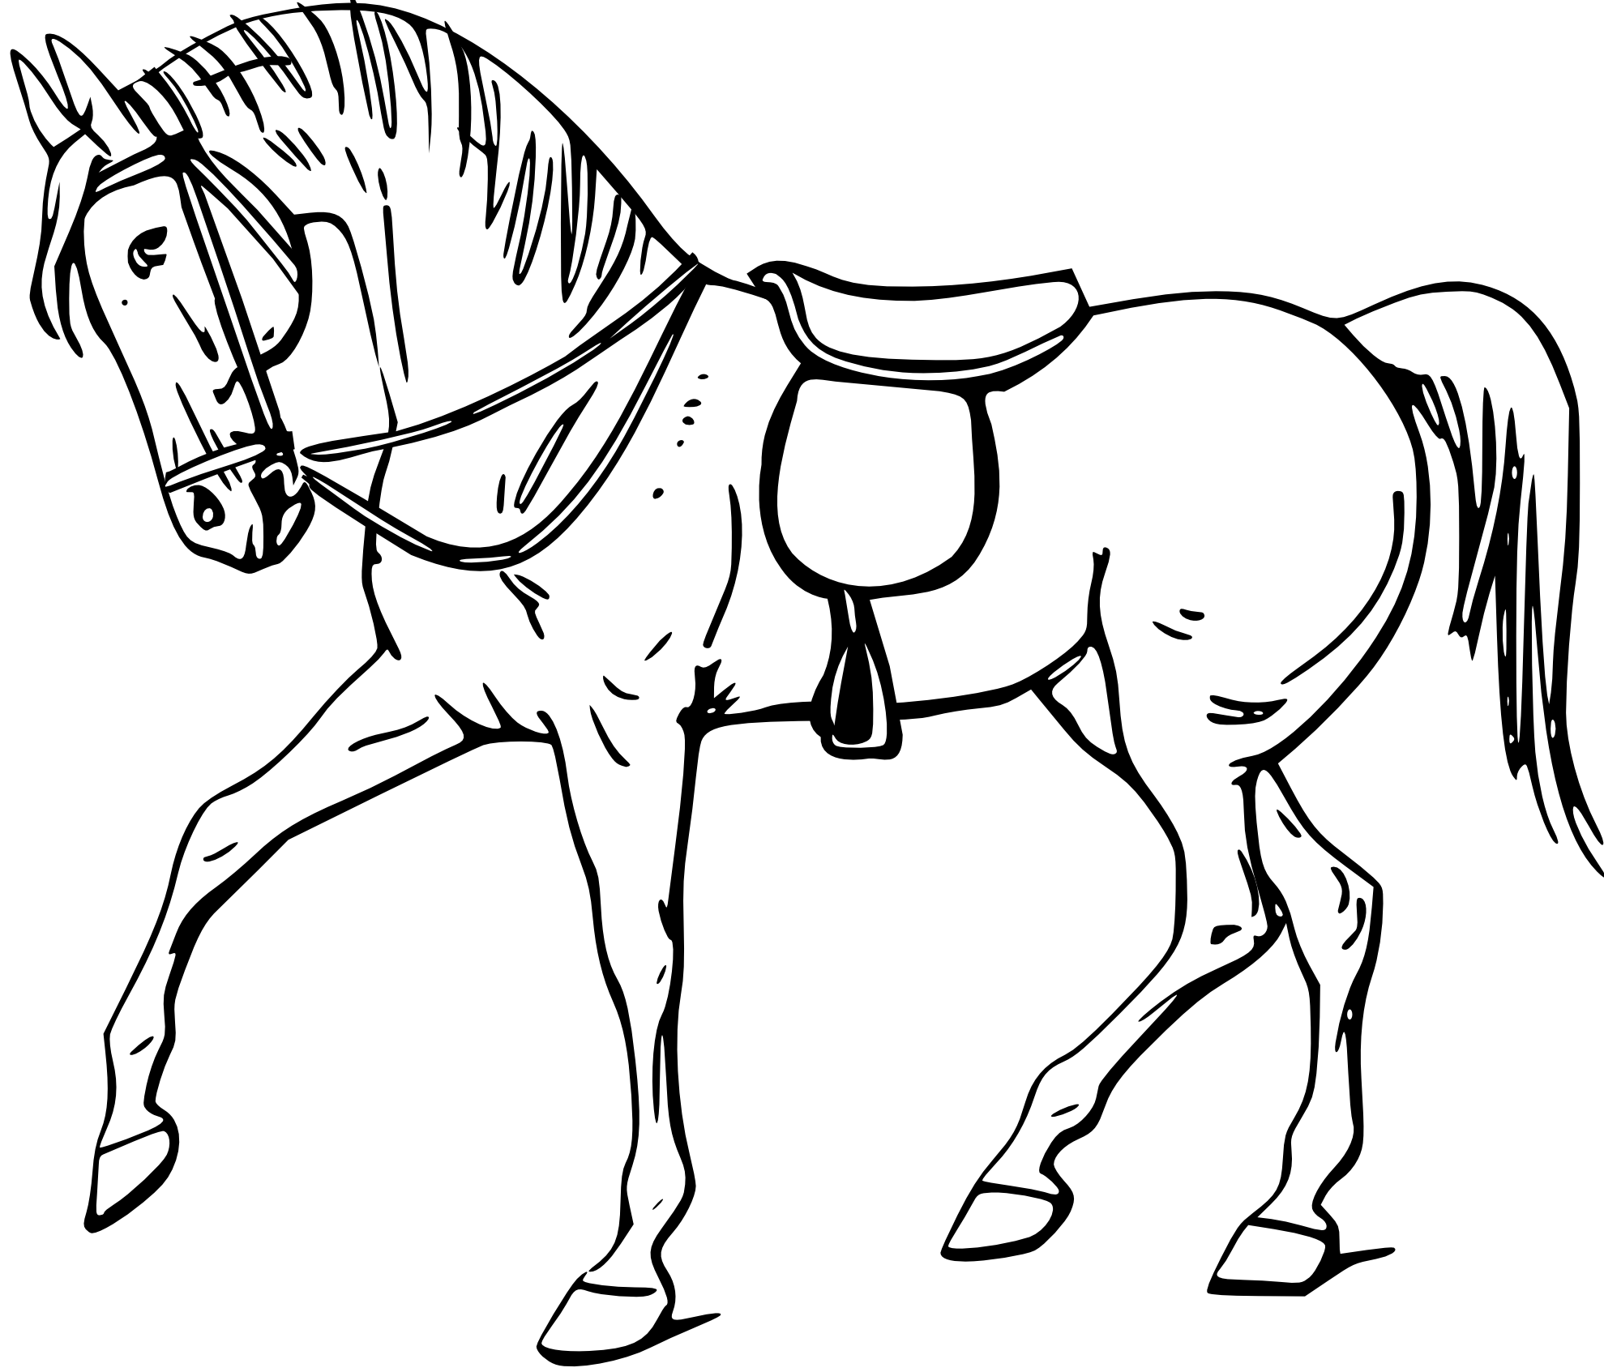
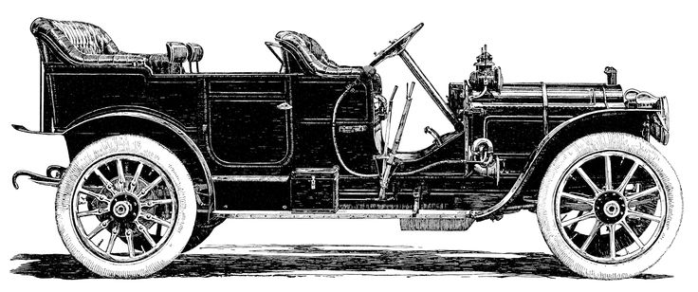
Notes:
The car was a disruptive innovation that enabled humans to travel greater distances faster, but like other disruptive innovations, before the car was invented, humans couldn’t even imagine such a thing.

Slide 7
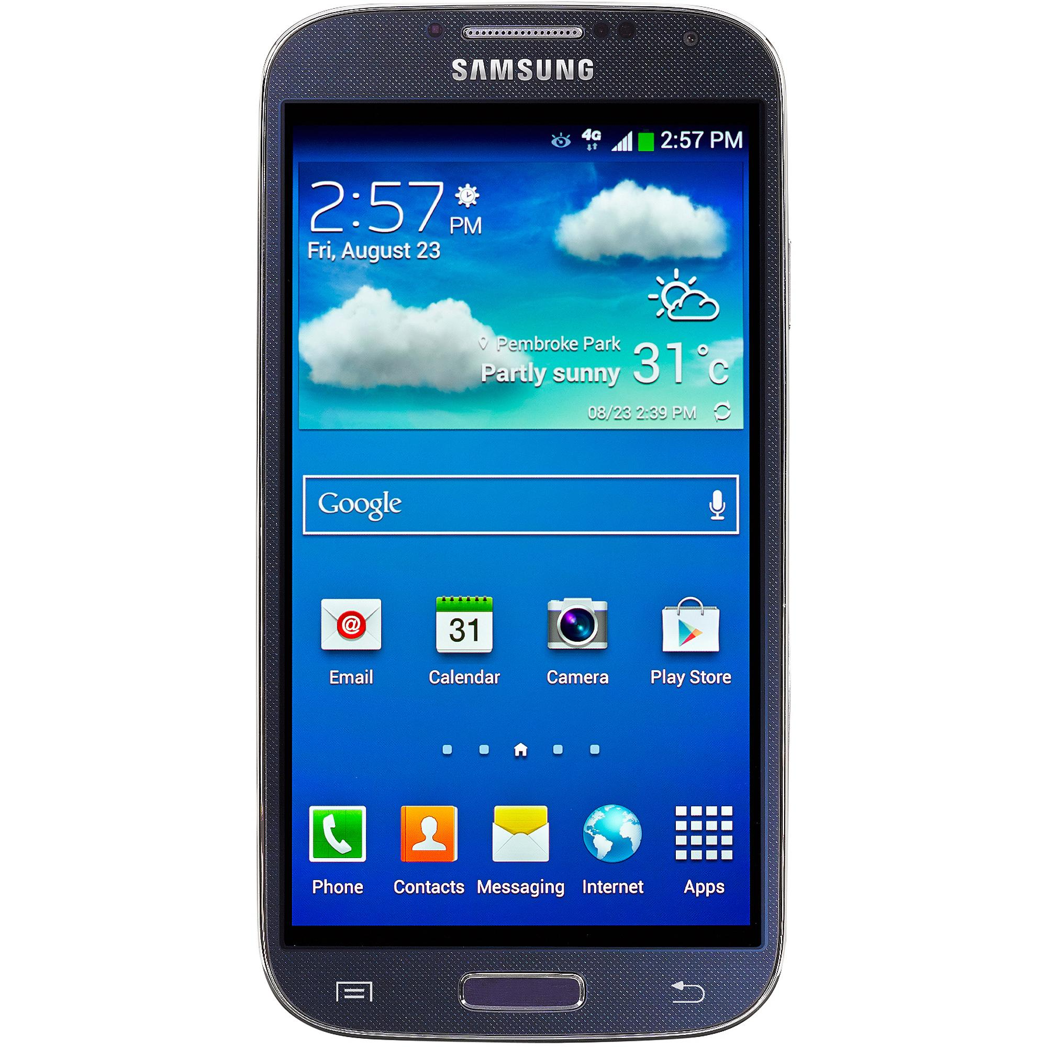
Notes:
A more modern example of disruptive innovation is the journey many of us have taken from the landline to the mobile phone to the smartphone. All of this has happened within the past 20 years, but its hard to remember a time without a phone in our pocket and all the conveniences that come with it.

Slide 8
ЧАСТИЧНАЯ:
незначительное улучше-ние существующих решений или применение существующих решений к разрешению новых проблем
Notes:
Another type of innovation, that is often less recognized, is incremental innovation. It’s a modest improvement to existing solutions or application of an existing solution to a new problem. So for instance…

Slide 9
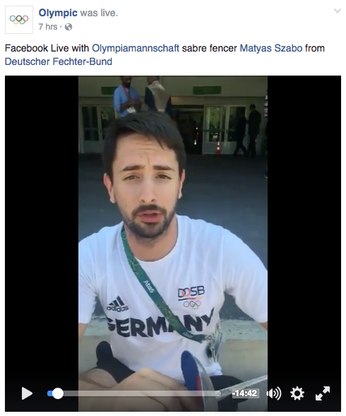
Фотографии
Видеоролик
Прямой эфир в Фейсбуке
2005
2007
2016
Notes:
When Facebook initially launched, the platform allowed users to share photos with friends. Two years later, they enabled users to upload video so they could share events and information in a different way. Just this year they enabled Facebook Live that allows people to stream live events on the platform. Each of these incremental innovations added value for Facebook users. The problem stays the same – people’s desire to share and experience events -- with Facebook continuously offering new solutions that expand the way people can do that.

Slide 10
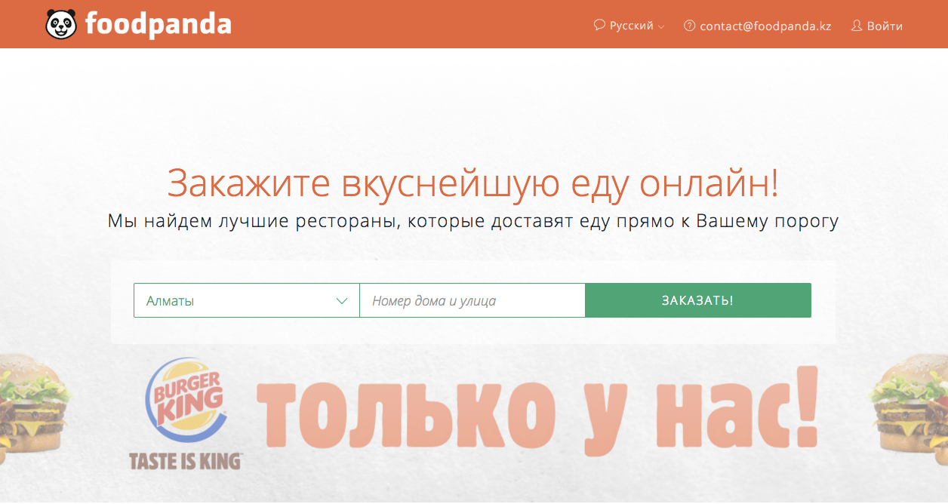
РЕСТОРАНЫ
+
ЗАКАЗЫ ОНЛАЙН
=
Notes:
Throughout history humans gotten hungry and some fill that need for food at restaurants. For the past decade or so, people have been able to purchase things online, initially starting with things like plane tickets and books. Innovators around the world have been applying these two existing solutions -- eCommerce and restaurants to create new localized services such as Food Panda where you can choose from menus of many different restaurants and order quickly and easily online. It’s not revolutionizing the way we live, but it’s a convenient new service that addresses a new problem – people’s demand for faster and more convenient food delivery.

Slide 11
НОВОЕ
ЧАСТИЧНЫЕ
ПРОРЫВНЫЕ
Решение
ЧАСТИЧНЫЕ
СУЩЕСТВУЮЩЕЕ
СУЩЕСТВУЮЩАЯ
НОВАЯ
Проблема
Notes:
So to recap, you have existing solutions and new solutions. You have existing problems and new problems. Disruptive innovations address new problems with new solutions in ways that totally change the way things are done. Incremental innovations don’t completely disrupt the status quo, but do create value through solving existing problems with new solutions or identifying new problems that can be addressed through existing solutions.

Slide 12
Notes:
The interesting thing about true innovations are that they offer value once they exist, but are often not recognized as problems or solutions before they exist. In other words, once we have access to them, we can’t imagine what life was like without them, but looking back, we were just going on as normal not realizing what big or small improvements could do. It takes creativity and vision to see and create innovation. Those with the vision are often ridiculed or seen as dreamers, told their ideas are crazy. Naysayers are often proved wrong as soon as the innovation is realized.

Slide 13
Итак, что означает инновация для гражданского общества?
Notes:
So that’s all great, but I imagine what you want to know is what does innovation mean for civil society and how can you innovate? Well…

Slide 14
Проблема гражданского общества
Идея
Инновация
Результаты
Новая проблема
ИЛИ
Новое
решение
Notes:
In civil society we face various problems. Just like in the previous examples, civil society innovations can address existing problems or identify new ones that no one has been working on. We can come up with totally new solutions or adapt and apply solutions to problems we’re working on. For instance…

Slide 15
ПРОГРАММНАЯ ИННОВАЦИЯ
разрешает социальную проблему и приносит ценность заинтересо-ванным сторонам
Notes:
We can have programmatic innovations that help you work towards your mission and bring value to the people and organizations you work with. A great example of this is…

Slide 16
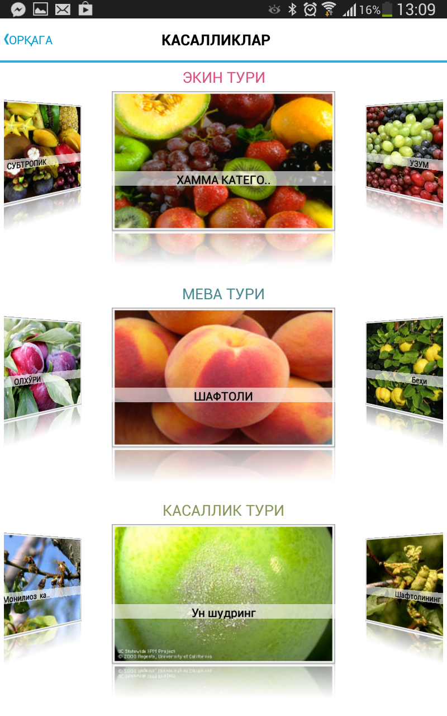
MEVA APP
Top 5
in UZ
Notes:
The MEVA App in Uzbekistan. A USAID project was printing agricultural best practices, they used to spend $90k a year printing full-color agricultural guides, but couldn’t print enough for all the farmers that wanted them. They’d distribute them to farmers cooperatives that would end up photocopying the guides in black and white. This lost a lot of the image quality and details that were useful to diagnosing pests and disease. They noticed that many of the farmers they were working with had smartphones, however, and spent $5k to develop an app that could be shared on USB, over bluetooth or downloaded from the Google play store. The app became wildly popular and has been one of the 5 most downloaded apps in Uzbekistan. They took an existing problem of getting agricultural advice to farmers and used a new solution – an app – to drastically increase the number of people they could reach. They are currently improving the app and adding features based on feedback from the farmers that are using it.

Slide 17
ОПЕРАЦИОННАЯИННОВАЦИЯ
совершенствует управление организа-циями гражданского общества и реализацию программ
Notes:
Operational innovations help your organization operate more efficiently and effectively. It could be something like

Slide 18
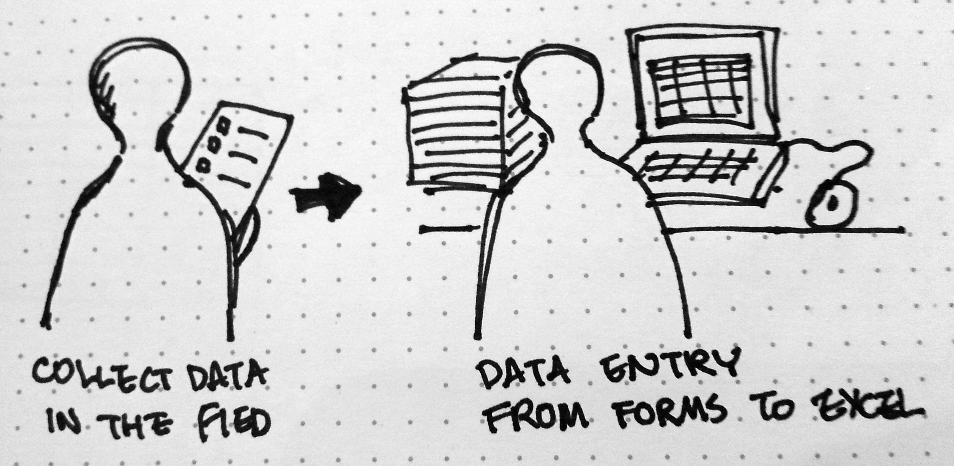
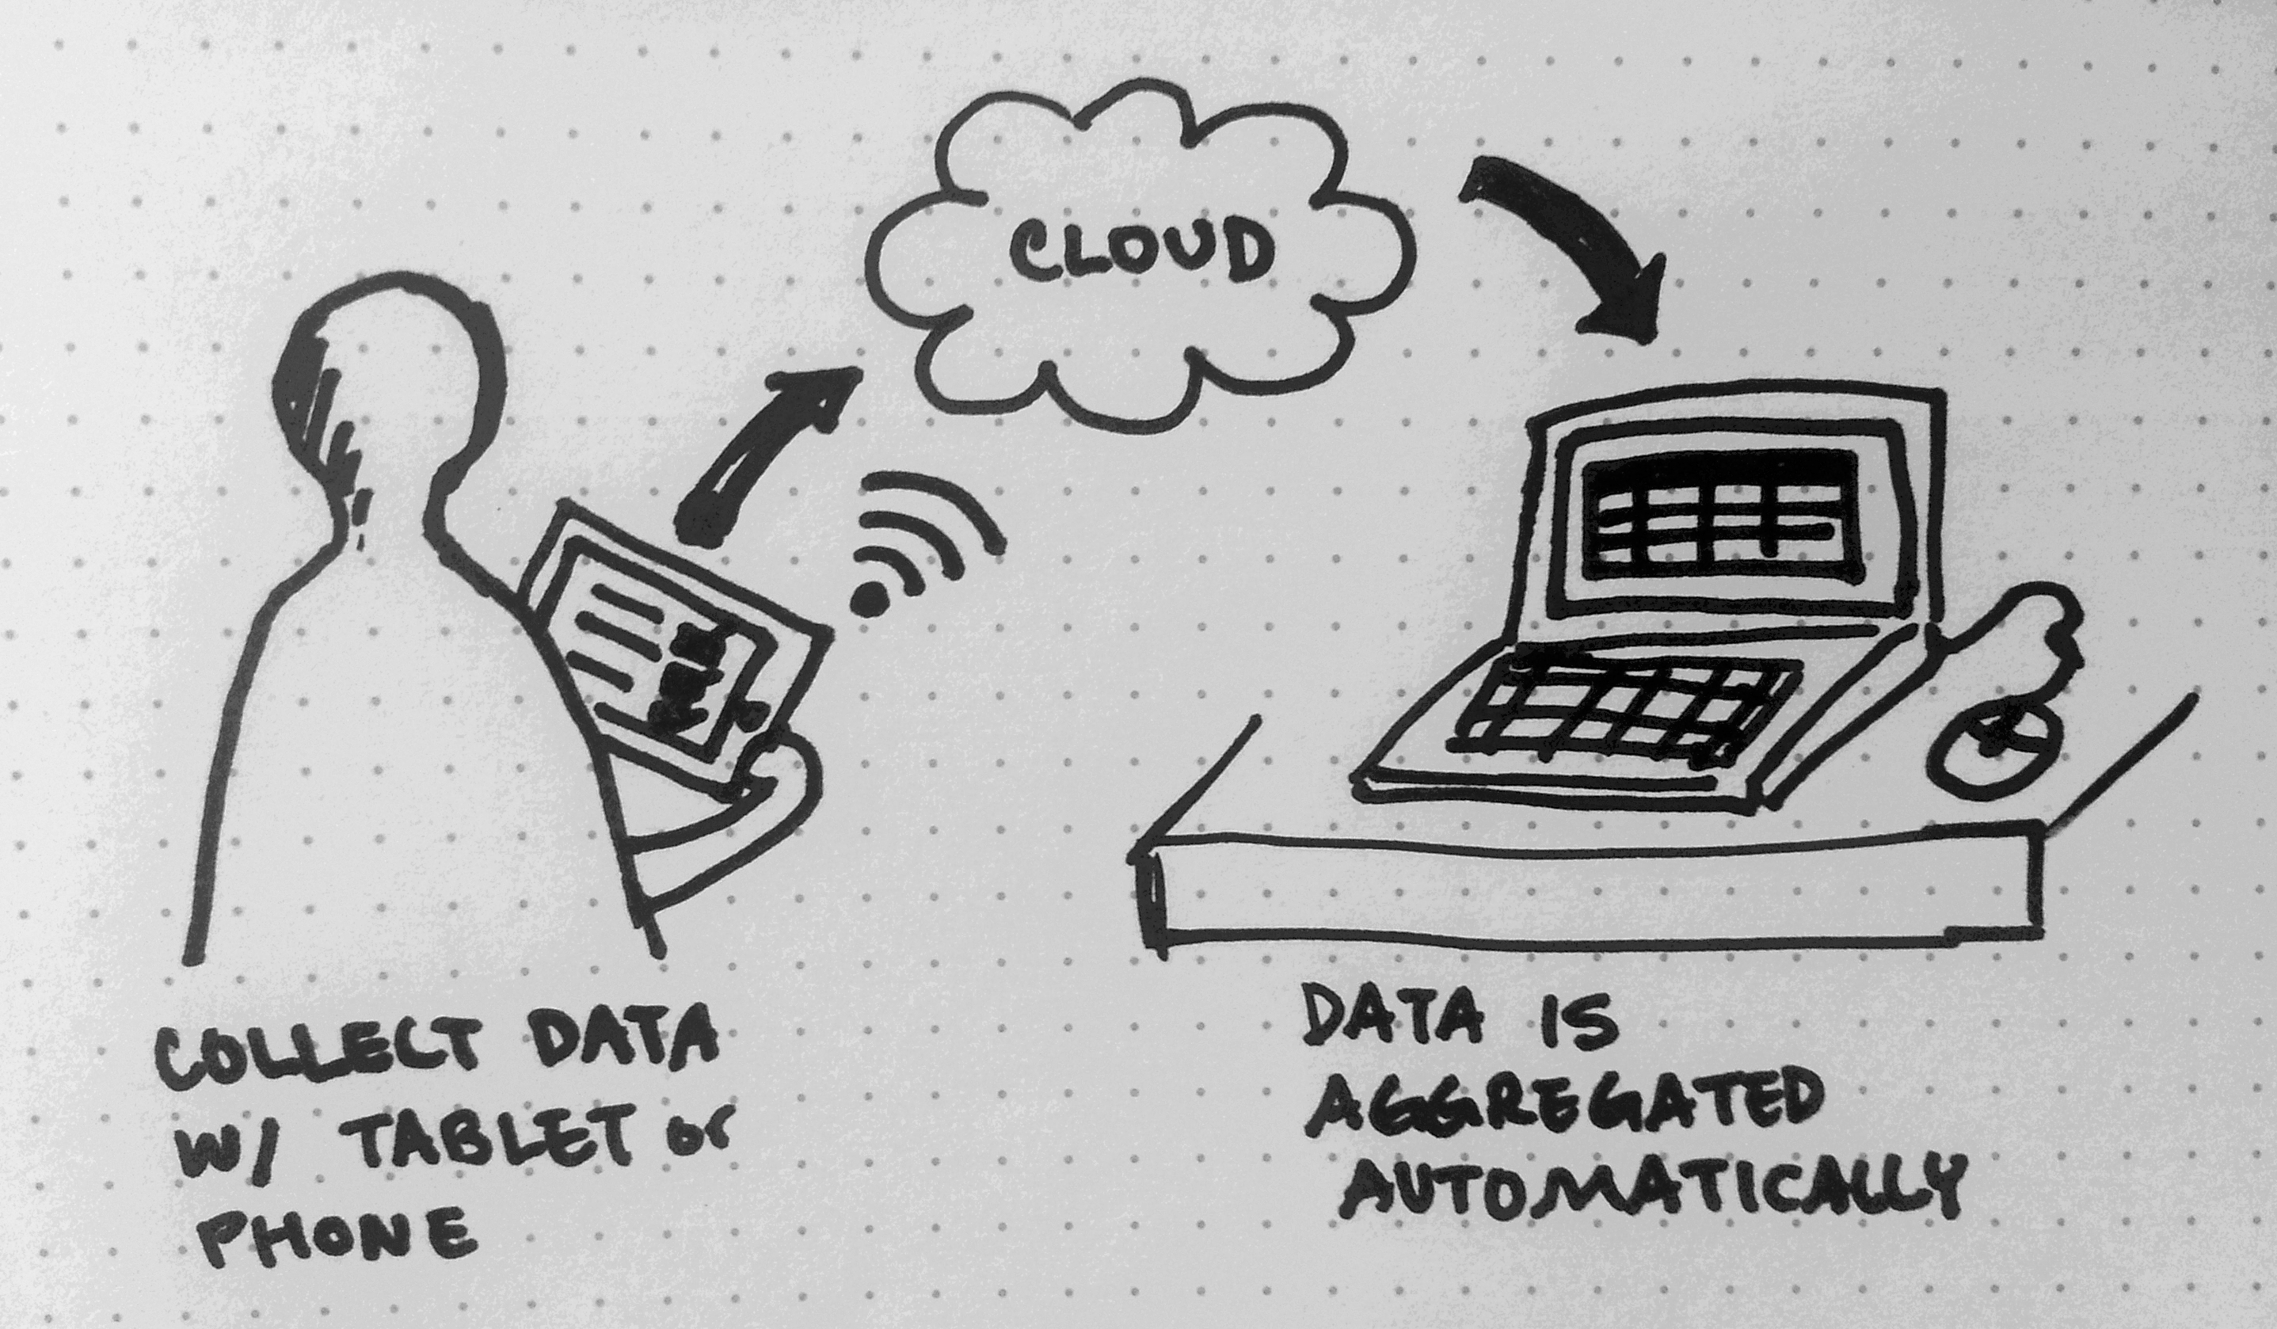
Сбор цифровых данных
Images from UNICEF Blog
Notes:
using mobiles to collect data digitally. Instead of collecting paper surveys that take days or weeks to input, some organizations have begun collecting survey data on phones or tablets that automatically upload information to a central database.

Slide 19
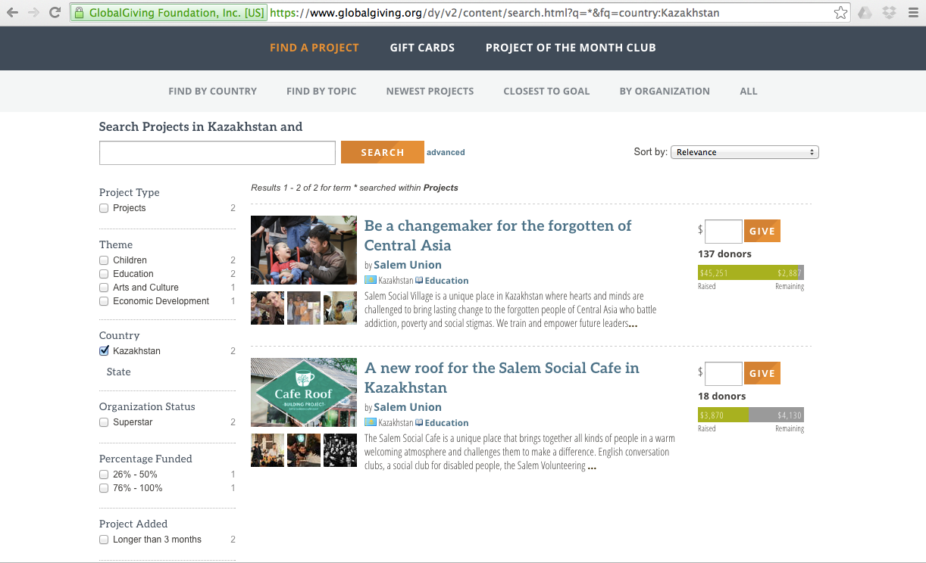
Глобальные пожертвования
Notes:
Other organizations, some here in Kazakhstan, are using new methods for getting funding. For example, putting project descriptions on sites like global giving, a crowdfunding platform where organizations can solicit small donations from many people located around the world.

Slide 20
В чем секрет успешной инновации?
Notes:
So this all sounds good, but what’s the secret to successful innovation?

Slide 21
Проблема гражданского общества
Идея
Инновация
Результаты
Ключевые Принципы
на основе Внедрение инноваций в Граждан-ском Обществе
Notes:
At first glance innovation might look like just what you do with a regular civil society funding proposal – identifying a problem, describing an idea of how you will solve it and implementing to get results. But the secret to innovation is HOW you move from idea to innovation to results. Let me briefly share some of the key principles for innovation from Innovating in Civil Society

Slide 22
Делайте небольшие ставки
Не вкладывайте все свои ресурсы в одну БОЛЬШУЮ не прове-ренную идею!
Сначала апробируйте несколько небольших идей – посмотрите, что из этого выйдет.
Notes:
First, TAKE SMALL BETS. The nature of innovation is that we don’t know if it will work – it’s new! Innovators expect some failure and are okay with it. But recognizing that not everything will be a success, innovators don’t risk all of their resources on one BIG untested idea. Take small bets at first. That way you can see which ones work and further invest in them rather than spending all your time and funding on a single idea that may not work in the end.

Slide 23
Сделайте акцент на своих пользователях
Notes:
FOCUS ON YOUR USERS. You can learn a lot about what is working and what is not just watching your users. We can quickly identify issues with our design when we take the time to observe.

Slide 24
Откорректируйте свой план
РЕЗУЛЬТАТ
Notes:
ADJUST YOUR PLAN. In civil society we often operate as if there is one path from our idea to our outcome. We are encouraged to write proposals like this as if it is that simple, but with the bold new ideas required for innovation, it isn’t that simple. Since innovative ideas are untested, it’s critical that when you see something isn’t working, adjust the plan. This can be tricky with donor proposals that often include specific outputs, but there are ways to write proposals that will leave room for adjustment while ultimately getting to the desired outcome.

Slide 25
Внедряйте с учетом интересов различных заинтересованных сторон
$
$
Notes:
ACCOMMODATE DIVERSE STAKEHOLDERS. Also make sure you test your innovation with a diverse group of stakeholders. Men, women, young, old, rich, poor, urban, rural…. Whoever can use or support the innovation. If you design something for all citizens, but only test with young urban men, it may not work for the rest.

Slide 26
Планируйте только проверенные решения
✗
✗
✓
Notes:
And lastly, ONLY SCALE TESTED SOLUTIONS. Take your small bets. adapt your idea based on what you learn from diverse users. Figure out what works and invest your resources in what works! That’s when innovation will yield the most impact!

Slide 27
Теперь Вы готовы к внедрению инноваций!
Notes:
Now you are ready to innovate. Thank you!

